Slide 1
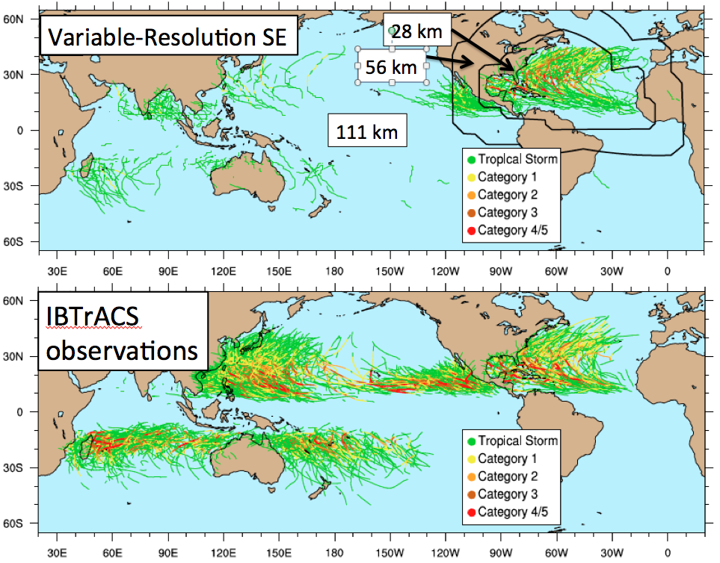
Variable-Resolution Modeling Zooms into Atlantic Hurricane Seasons at Reduced Computational Costs
Objective
Evaluate the ability of the DoE/NCAR Community Atmosphere Model (CAM5) with its variable-resolution Spectral Element (SE) dynamical core to replicate historical hurricane statistics over the North Atlantic.
Approach
CAM5-SE simulations (23 years) with prescribed sea surface temperatures and sea ice were conducted following the Atmospheric Model Intercomparison Protocol (AMIP).
CAM5-SE is configured with a variable-resolution grid that ranges from 111- 28 km. The 28 km grid zooms into the Atlantic basin to focus on hurricanes.
Factor of 6 quicker than uniform 28 km simulation. Identical time step is used.
Global distribution of tropical storm trajectories from 1980 to 2002 in the (top) variable-resolution CAM5-SE simulation, and (bottom) IBTrACS observational data set. Storm paths are color coded by intensity at each location in their trajectory. With a grid spacing of 111 km only very few and weak tropical storms are simulated.
Impact
Tropical cyclone simulations require high-resolution grids. The variable-resolution configuration of the CAM5-SE model replicates Atlantic hurricane statistics at reduced computational cost. It shows that the var-res CAM5-SE model is a skillful tool for regional climate assessments.
Zarzycki, C. M. and C. Jablonowski (2014): A multidecadal simulation of Atlantic tropical cyclones using a
variable-resolution global atmospheric general circulation
model. J. Adv. Model. Earth Syst., Vol. 6, 805-828
Notes:
AGU Publication Highlight (Nov/6/2014): https://www.magnetmail.net/actions/email_web_version.cfm?recipient_id=1021841265&message_id=7564245&user_id=AGU_&group_id=1048659&jobid=22993599
Article available at: http://onlinelibrary.wiley.com/doi/10.1002/2014MS000352/full

