Slide 1
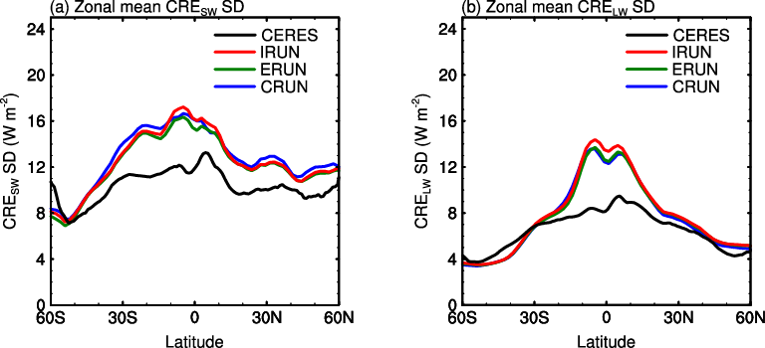
Impacts of El Niño and Aerosols on Cloud Radiative Effects
Objective
Determine the relationships between cloud radiative effects and El Niño events, and quantify contributions of natural aerosol variability and cloud fraction to interannual variations in cloud radiative effects.
Approach
Perform simulations with and without interannual variations of emissions and concentrations of natural aerosols.
Apply statistical analysis for the cloud radiative effects.
Quantify the changes in cloud radiative effects due to the variability of emissions and concentrations.
Estimate the contributions of cloud fraction and natural aerosols to the variations in cloud radiative effects.
Observed and simulated zonal mean of standard deviation of shortwave and longwave cloud radiative effects. Black line represents values from CERES-EBAF observations. Red, green, and blue lines represent values from the IRUN, ERUN (without emissions variability), and CRUN (without concentration variability) of CESM model simulations.
Impact
Aerosols contribute to 10–30% of the interannual variability of cloud radiative effects over the tropics.
Yang Y, LM Russell, L Xu, S Lou, MA Lamjiri, RCJ Somerville, AJ Miller, DR Cayan, MJ DeFlorio, SJ Ghan, Y Liu, B Singh, H Wang, J-H Yoon, PJ Rasch. 2016. “Impacts of ENSO Events on Cloud Radiative Effects in Preindustrial Conditions: Changes in Cloud Fraction and Their Dependence on Interactive Aerosol Emissions and Concentrations. Journal of Geophysical Research: Atmospheres 121. DOI: 10.1002/2015JD024503
Notes:
https://www.pnnl.gov/science/highlights/highlights.asp?division=749

