Slide 1
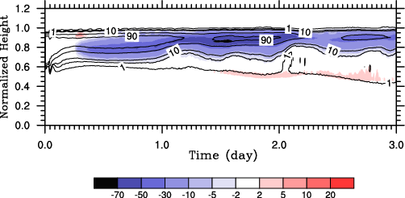
Impact of Subgrid-scale Radiative Heating Variability on the Stratocumulus-to-Cumulus Transition in Climate Models
Objective
Understand the impact of subgrid-scale radiation-turbulence interaction on climate simulations of marine low clouds
Approach
Use large eddy simulation (LES) to study the stratocumulus-to-trade cumulus (Sc-to-Cu) transition in a climate model grid column
Artificially remove small-scale radiation-turbulence interaction in the LES by replacing the radiative heating rate at each grid point with the horizontal mean to mimic climate model parameterizations
Impact of averaged radiative heating on cloud fraction
Contours = Cloud Fraction; Shading = Change in Cloud Fraction
Decreasing stratus
Increasing
cumulus
The lack of subgrid-scale turbulence-radiation interaction, as is the case in current generation climate models, accelerates the Sc-to-Cu transition, as shown by the changes in cloud fraction.
Impact
Lack of subgrid-scale radiation-turbulence interaction results in an earlier transition from a stratocumulus to a cumulus regime
Physical explanation for the impact points to possible ways of including subgrid-scale radiation-turbulence interaction in turbulence parameterizations like CLUBB.
Xiao H, WI Gustafson, and H Wang. 2014. “Impact of Subgrid-Scale Radiative Heating Variability on the Stratocumulus to Trade Cumulus Transition in Climate Models.” Journal of Geophysical Research, early online. DOI: 10.1002/2013JD020999
Notes:
http://www.pnl.gov/science/highlights/highlights.asp?division=749
Acknowledgements. Funding for this manuscript has been provided by a U.S. Department of Energy (DOE) Early Career grant awarded to Dr. Gustafson. H. Wang also acknowledges support from the DOE Earth System Modeling Program. The Environmental Molecular Science Laboratory and the Pacific Northwest National Laboratory Institutional Computing program provided high performance computing resources. The Pacific Northwest National Laboratory is operated for DOE by Battelle Memorial Institute under Contract No. DE-AC05-76RL01830.

