Slide 1
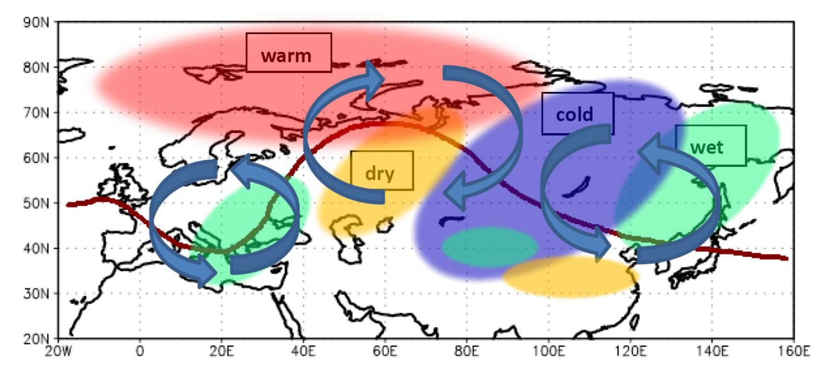
Winter Weather Patterns over Northern Eurasia and Arctic Sea Ice Loss
Objective
Wind variations, especially surface wind variations, play important roles in regulating air-sea and air-land interactions by means of affecting heat flux and water evaporation, thus further influencing soil moisture and the hydrological cycle. Through analyzing two sets of reanalysis atmospheric data, here we study the changes of the winter daily 850hPa wind patterns over Eurasia continent in recent 33 years. Then we relate the changes of this winter pattern to the reduction of the Arctic sea ice.
Schematic of how reduced Arctic sea ice affects winter SAT and precipitation tendencies across Eurasia, arrows denote the spatial distribution of anomalous anticyclone and cyclone associated with the negative phase of the tripole wind pattern in the lower-troposphere, the brown line represents 500 hPa height isoline, yellow and green areas indicate less and more precipitation, respectively, red and purple areas respectively depict positive and negative SAT anomalies.
Approach
Daily NCEP/NCAR and the Japanese reanalysis data sets of surface temperature, winds, 850 hPa wind and 500hPa geopotential height from Dec. 1, 1979 to Feb. 28, 2012.
The major method used in this study is the complex vector empirical orthogonal function analysis which is applied to the region over 40º-120ºE, 40º-70ºN.
The Monte Carlo method is applied to determine statistical field significance.
Impact
A tripole wind pattern is found in Eurasia continent which show a downward trend. This trend is associated to the fall Arctic sea ice anomalies and leads to the cold winters in the East Asia region.
The results here imply that East Asia may experience more frequent and/or intense winter extreme weather events in association with the loss of Arctic sea ice.
Wu, B., D. Handorf, K. Dethloff, A. Rinke, and A. Hu, 2013: Winter Weather Patterns over Northern Eurasia and Arctic Sea Ice Loss. Mon. Wea. Rev., doi:10.1175/MWR-D-13-00046.1, in press.

