Slide 1
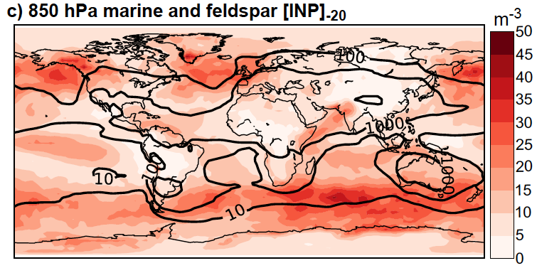
A Marine Biogenic Source of Atmospheric Ice Nucleating Particles
Objective
Determine the contribution of marine biogenic particles to atmospheric ice nuclei, testing the question posed by Burrows et al. (2013, ACP): “Ice nuclei in marine air: biogenic particles or dust?”
Approach
Utilize new measurements of ice nucleating particles (INP) in organic matter collected from the sea surface microlayer.
Develop a parameterization of the number of INP per gram of marine organic matter as a function of temperature.
Use global atmospheric models to produce distributions of marine organic INP, and compare these to a global model estimate of INP from mineral dust (feldspar).
Comparison of the modeled concentrations, at 850 hPa, of ice nucleating particles at -20° C ( [INP]-20 ) originating from a marine biogenic source (filled contours) and from feldspar (solid contour lines) shows that marine biogenic particles are estimated to be a competitive source of INP over much of the remote Southern Ocean.
Impact
Southern Ocean clouds have a much higher fraction of supercooled water than clouds in the northern hemisphere.
This effect is not represented in current global climate models, which typically use aerosol-independent freezing designs. More sophisticated methods still depend only on dust or total particles.
This study helps to quantify the importance of marine biogenic particles as a source for INP in remote marine areas, and could be used to improve models in the future.
TW Wilson, et al. 2015. “A Marine Biogenic Source of Atmospheric Ice Nucleating Particles.” Nature 525: 234-238. 10 Sept 2015. DOI: 10.1038/nature14986
Notes:
http://www.pnnl.gov/science/highlights/highlights.asp?division=749

