Slide 1
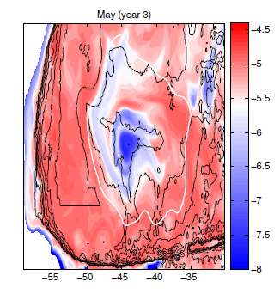
Ocean currents alone cannot explain the Zapiola Rise
Objective
The Zapiola Rise is a large deposit of sediments in the Argentine Basin that strongly controls ocean circulation.
Here we study whether eddy-driven sediment transports can explain existence and growth of the Zapiola Rise.
Approach
Run Parallel Ocean Program (POP) in eddy-resolving configuration for 6 yr.
Source of sediments in La Plata estuary
Different size classes (neutral, clay, and silt).
Study sediment transport and sedimentation patterns.
Concentration (log) of silt size fraction at 1600 m depth in the Argentine Basin. White line denotes the boundary of the Zapiola Anticyclone, which prevents sediments from reaching the crest of the Zapiola Rise (closed black contour centered at 45°S, 45°W).
Impact
Zapiola Rise strongly influences ocean circulation in Argentine Basin.
Eddy-driven sediment transport alone cannot explain its existence.
Wilbert Weijer, Mathew E. Maltrud, William B. Homoky, Kurt L. Polzin, and Leo R. M. Maas, 2015: Eddy-driven sediment transport in the Argentine Basin: Is the height of the Zapiola Rise hydrodynamically controlled? Journal of Geophysical Research, 120, doi:10.1002/2014JC010573.

