Slide 1
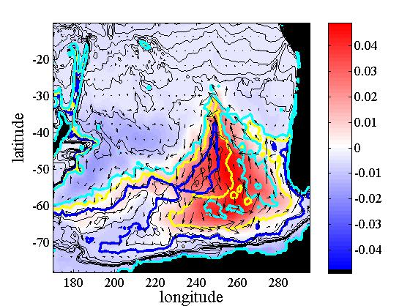
Topographically-trapped ocean variability dominates wind-driven circulation in the Bellingshausen Basin
Objective
Certain abyssal plains allow the ocean to trap huge amounts of wind energy.
Here we study the energetics of the topographically-trapped circulation in the Bellingshausen Basin during a particularly energetic event in 2009.
Approach
Run a 1-layer shallow-water model, configured for the Southeast Pacific Ocean.
Determine modes of the basin, through normal mode and EOF analysis.
Determine energy budgets of modal and non-modal circulation.
Dominant EOF of sea surface height variability (shading) and associated velocity field (vectors). Contours show select contours of barotropic potential vorticity, f/H.
Impact
The ocean circulation in the Bellingshausen Basin is dominated by a topographically trapped mode.
It dispends its energy at only a few locations, which could locally enhance mixing.
Weijer, W., 2015: Modal variability in the Southeast Pacific Basin: Energetics of the 2009 event. Deep-Sea Research II, 114, 3-11, doi: 10.1016/j.dsr2.2012.10.002.

