Slide 1
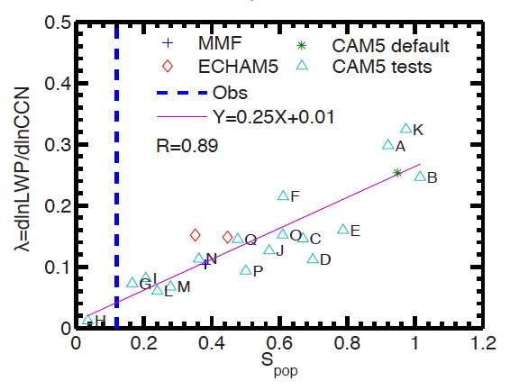
Satellite observations imply that cloud lifetime effects of aerosol are overestimated in global climate models
Objective
Constrain cloud lifetime effects of aerosols in global climate models
Approach
Coincident observations of aerosols, clouds and precipitation from A-Train satellite are used to derive rain frequency susceptibility to aerosols (S_{pop})
Global climate models, including a multi-scale aerosol-climate (PNNL-MMF) are used to link rain frequency susceptibility to cloud lifetime effects of aerosols.
Detailed cloud microphysical rates are examined to understand model deficiencies in simulating cloud lifetime effects of aerosols
S_{pop} derived from A-Train satellite observations (dotted line) suggested a much weaker liquid water path response to aerosol perturbation in global climate models
Strength of LWP response to aerosol perturbations
Impact
S_{pop} provides a metric to guide the development and evaluation of new parameterizations of aerosol indirect effects.
The constraints in cloud lifetime effects of aerosols provided by S_{pop} make it possible to use the past observational record of surface air temperature to constrain climate sensitivity
Wang M, SJ Ghan, X Liu, T L'Ecuyer, K Zhang, H Morrison, M Ovchinnikov, RC Easter, RT Marchand, D Chand, Y Qian, and JE Penner. 2012. “Constraining Cloud Lifetime Effects of Aerosols Using A-Train Satellite Observations,” Geophysical Research Letters 39:L15709. DOI:10.1029/2012GL052204.
Notes:
http://www.pnnl.gov/science/highlights/highlight.asp?id=1192
Atmospheric Sciences & Global Change Division
Research Highlights
August 2012
How to Catch Aerosols in the Act
Scientists use satellites to measure how pollution particles affect clouds
Results: Grabbing a virtual tiger by the tail, scientists led by researchers at Pacific Northwest National Laboratory directly linked a cloud’s inclination to rain to its effects on the climate. Using global satellite data and complex calculations, they were able—for the first time—to develop a proxy measurement for one of the most vexing questions in atmospheric science: how tiny particles in the atmosphere affect the amount of cloud. Using this new metric, they showed that aerosols’ effects on clouds are overestimated by as much as 30 percent in a global climate model.
“Our study helps narrow the large aerosol-cloud interaction uncertainties in projections of future global warming,” said Dr. Minghuai Wang, atmospheric scientist at PNNL and lead author of the study. “Wide ranges of estimates in aerosol effects on clouds have made it challenging to understand how clouds really affect the climate.”
Why It Matters: Understanding clouds and their effects on climate is a formidable challenge in trying to predict how the climate will change by the end of the century. On the line are questions of future melting of the polar ice, drought and water shortages, and increases in extreme weather events. One particularly tough question is how tiny pollution-caused particles in the atmosphere will affect clouds. This study shows how satellite observations can be used to hone in on aerosol effects on clouds and make it possible to better understand how clouds will affect climate.
“The use of satellite observations in studying climate processes like these is absolutely critical because it is the only way to obtain cloud and aerosol measurements over the whole globe,” said Dr. Mikhail Ovchinnikov, PNNL atmospheric scientist and co-author of the study.
Methods: The study, led by PNNL scientists, constructed a new metric for rain frequency susceptibility, then closely correlated that metric to the aerosol effect on cloud amount, which is the total amount of water in the cloud and the cloud’s size. This metric, along with satellite measurements, was then used in three global climate models to find new ranges of cloud amount change due to pollution-caused aerosol particles, compared to current estimates.
The team, for the first time, used “A-Train” satellite observations which collect coincident global measurements of aerosols, clouds, and precipitation to develop a new metric, termed rain frequency susceptibility or “S-POP.” This metric provides a quantitative measure of the sensitivity of rain frequency to the amount of aerosols in clouds. Next, they showed how S-POP is closely correlated to aerosols’ effects on cloud amount, using three global climate models, including a multi-scale aerosol climate model developed at PNNL (PNNL-MMF) that embeds a cloud-resolving model at each grid column of a host global climate model.
Finally, the relationship between S-POP and the aerosol effects on cloud amount from the global climate models together with the observed rain frequency susceptibility from A-Train observations are used to estimate aerosol effects on cloud amount in global climate models. They showed that in one global model, the National Center for Atmospheric Research’s Community Atmosphere Model version 5 (CAM5), aerosol effects on clouds were overestimated by 30 percent.
This research also provides a guide for the development and evaluation of new parameterizations, techniques to computationally represent complex small-scale systems, of aerosol effects on clouds in global climate models.
What’s Next? The researchers plan to apply S-POP to evaluate cloud amount based on rain frequency susceptibility in other global climate models, and guide further improvement of the aerosol indirect effects estimations in CAM5 and the PNNL-MMF multi-scale aerosol-climate model.
Sidebar: Aerosols and Clouds Tiny particles in the atmosphere from human-caused pollution act as seeds to form cloud water droplets. The size and numbers of these particles makes a difference in how large or reflective a cloud is. The more numerous the particles, the smaller the cloud droplets. Numerous tiny droplets create really bright clouds reflecting more of the sun’s energy away from Earth. And, these numerous and smaller droplet sizes relate to what scientists call the cloud lifetime effect, describing aerosol particle effects on both the total water amount in the cloud and its size. Accounting for these various effects–which both cool and warm the planet–make aerosols’ effects on clouds one of the most nagging atmosphere and climate questions.
Acknowledgments: This work was supported by the NASA Interdisciplinary Science Program, and by the U.S. Department of Energy (DOE) Office of Science Atmospheric System Research program, the Scientific Discovery through Advanced Computing program, and the Decadal and Regional Climate Prediction using Earth System Models program. Additional support for collaborators was provided by the National Oceanic and Atmospheric Administration; U.S. DOE Atmospheric Radiation Measurement program; the National Science Foundation Science and Technology Center for Multiscale Modeling of Atmospheric Processes program, managed by Colorado State University; and the National Atmospheric and Space Administration. The work was performed by Drs. Minghuai Wang, Steven J. Ghan, Xiaohong Liu, Kai Zhang, Mikhail Ovchinnikov, Richard Easter, Duli Chand and Yun Qian of PNNL; Dr. Tristan L’Ecuyer of University of Wisconsin; Dr. Hugh Morrison of NCAR; Dr. Roger T. Marchand of University of Washington; and Dr. Joyce E. Penner of University of Michigan.
Reference: Wang M, SJ Ghan, X Liu, T L'Ecuyer, K Zhang, H Morrison, M Ovchinnikov, RC Easter, RT Marchand, D Chand, Y Qian, and JE Penner. 2012. “Constraining Cloud Lifetime Effects of Aerosols Using A-Train Satellite Observations,” Geophysical Research Letters 39:L15709. DOI:10.1029/2012GL052204.

