Slide 1
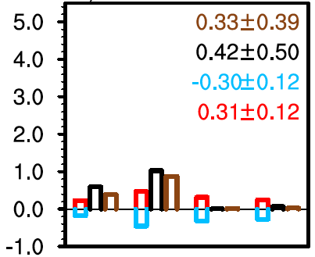
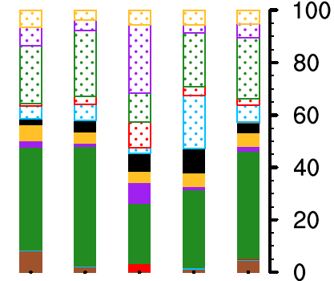
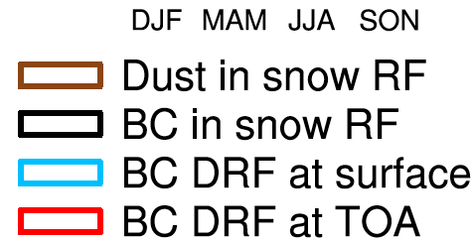
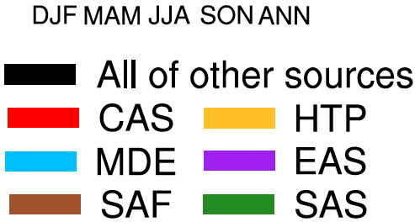
Source Attribution of Black Carbon over the Himalayas and Tibetan Plateau (HTP)
Objective
Quantify sources, transport, deposition, and radiative forcing of black carbon (BC) over the HTP and provide guidance for potential mitigation actions
Approach
Used the CAM5 model with source tagging to quantify BC contributions by region and sector (e.g. fossil fuel, biomass burning, etc.) to the atmosphere and deposited on snow/ice
Used surface BC measurements and satellite retrievals of snow cover to evaluate model results
Divided the HTP into five finer sub-regions to examine region-dependence of BC sources and radiative forcing, as well as in different seasons
BC deposited in-snow appears more important to snowmelt than particles suspended in air. (left);
Most BC on snow/ice comes from S. Asian biomass burning
Fossil fuel combustion
in E Asia also makes a significant contribution in summer (right)
Impact
Biofuel and biomass emissions in South Asia make the largest contribution to annual mean BC burden and deposition, followed by fossil fuel (FF) in South Asia, then FF in East Asia;
Contributions from different regions and sector sources depend on season and location
BC-in-snow forcing can cause earlier snow melting over the northwest plateau, especially in the spring
The results are relevant to mitigation actions
Zhang R, H Wang, Y Qian, PJ Rasch, RC Easter, PL Ma, B Singh, J Huang, and Q Fu. 2015. "Quantifying Sources, Transport, Deposition, and Radiative Forcing of Black Carbon over the Himalayas and Tibetan Plateau." Atmospheric Chemistry and Physics. 15:6205-6223. DOI:10.5194/acp-15-6205-2015.

