Slide 1
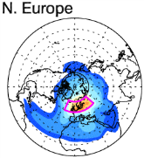
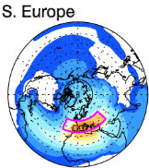
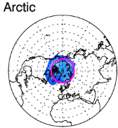
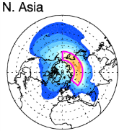
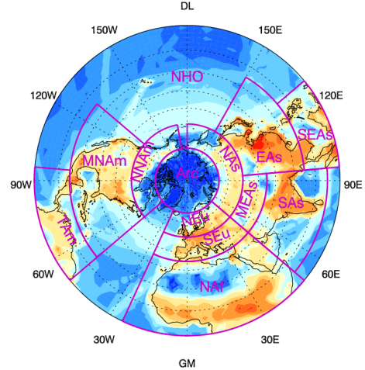
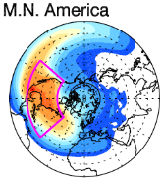
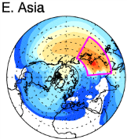
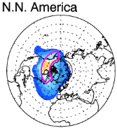
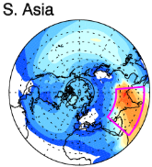
Tracking Emissions to Identify Sources and Transport Pathways of Arctic Black Carbon
Objective
Better understand sources of black carbon (BC) reaching the Arctic and the response of Arctic BC loading and radiative forcing to uncertainty and changes in emissions
Approach
Develop a new tagging technique in the Community Atmosphere Model (CAM5) to explicitly track BC emissions originating from major source regions
Conduct 10-year CAM5 simulations to establish global source-receptor relationships and transport pathways of BC, and characterize interannual variability
Quantitatively attribute Arctic BC loading, deposition and radiative forcing to regional sources
Small circles: contributions to Arctic BC from top 8 source regions, which are outlined in red. Large circle: annual BC emissions. [Warmer colors indicate larger contributions and emissions.]
Impact
The new tagging technique is much more computationally efficient than conventional emission perturbation approaches, making it affordable for studying interannual variability and using numerous source regions
Arctic BC and source attributions have strong seasonal variations; The interannual variability of annual mean Arctic BC burden and radiative forcing due to meteorology is small, but seasonal means have significant variability
Wang H, PJ Rasch, RC Easter, B Singh, R Zhang, P-L Ma, Y Qian, S Ghan, and N Beagley. 2014. “Using an Explicit Emission Tagging Method in Global Modeling of Source-receptor Relationships for Black Carbon in the Arctic: Variations, Sources, and Transport Pathways.” Journal of Geophysical Research: Atmospheres 119:12,888-12,909. DOI:10.1002/2014JD022297.
Notes:
http://www.pnnl.gov/science/highlights/highlights.asp?division=749

