Slide 1
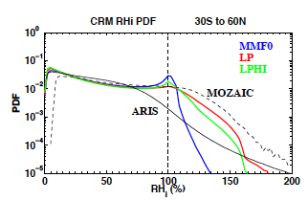
Investigating Ice Nucleation in Cirrus Clouds with an Aerosol-enabled Multi-scale Modeling Framework
Objective
Improve the treatment of ice nucleation in an aerosol-enabled multi-scale modeling framework (MMF)
Approach
Used an aerosol-enabled multi-scale modeling framework to account for cloud-scale motions in modeling ice nucleation by using the embedded cloud-resolving model on each grid column of the host climate model
Directly linked ice nucleation to aerosols, cloud-scale temperature, relative humidity and vertical velocity
Simulated probability distribution function (PDF) of relative humidity with respect to ice (RHI) in the original MMF (MMF0), and two versions of the improved MMF (LP and LPHI).
Impact
Improved MMF simulates persistent high ice super-saturation and low ice crystal number concentrations at cirrus temperatures, in better agreement with observations
Showed that improved MMF is a more powerful tool to simulate parameters, such as super-saturation, that evolve over short time scales.
Zhang C, M Wang, H Morrison, R Somerville, K Zhang, X Liu, and J Li. 2014. “Investigating Ice Nucleation in Cirrus Clouds with an Aerosol-enabled Multi-scale Modeling Framework.” Journal of Advances in Modeling Earth Systems 6, accepted. DOI: 10.1002/2014MS000343.
Notes:
http://www.pnnl.gov/science/highlights/highlights.asp?division=749

