Slide 1
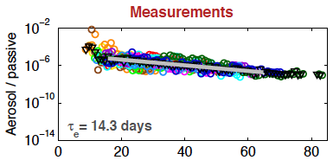
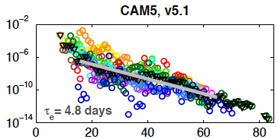
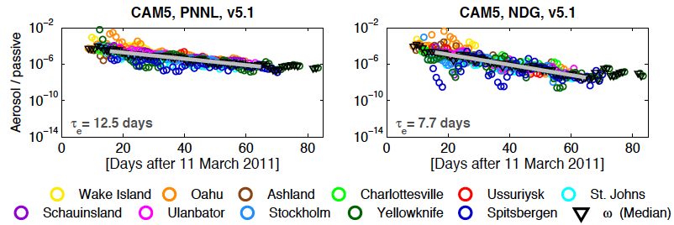
Using Observed Radioactive Tracers to Evaluate Aerosol Transport and Lifetimes in CAM5
Objective
Understand model configurations and parameterized processes affecting the removal, lifetime and long-range transport of aerosols in global aerosol-climate models
Approach
Used atmospheric measurements of radionuclides released from the Fukushima Dai-Ichi nuclear power plant (FD-NPP) accident in March 2011 to constrain and evaluate model simulations
Configured the CAM5 model with different meteorological nudging methods, vertical resolutions, and/or treatments of aerosol wet removal to simulate the lifecycle of FD-NPP radioactive isotopes and aerosols
Compared CAM5 with observations and 16 other models
Time series of measured and CAM5 modeled ratios of aerosol to passive tracer concentrations at 11 stations. τ_{e} is the e-folding lifetime and the gray line is an exponential decay fit to daily median ratios.
Impact
Modeled e-folding aerosol lifetimes, having a median of 9.4±2.3 days and a large spread (4.8-26.7 days), are shorter than the measured 14.3 days
Default CAM5 (v5.1) gives the shortest aerosol lifetime (4.8 days), while the CAM5-PNNL model has a much better estimate (12.5 days)
Improved representations of aerosol transport and wet removal (CAM5-PNNL) and a different nudging method (CAM5-NDG) also capture the measured longer aerosol lifetimes at higher latitudes (50-90°N)
Kristiansen NI, et al. “Evaluation of Observed and Modelled Aerosol Lifetimes Using Radioactive Tracers of Opportunity and an Ensemble of 19 Global Models.” 2016. Atmospheric Chemistry and Physics 16: 3525-3561. DOI:10.5194/acp-16-3525-2016
Notes:
http://www.atmos-chem-phys.net/16/3525/2016/acp-16-3525-2016.html
http://www.pnnl.gov/science/highlights/highlights.asp?division=749

