Slide 1
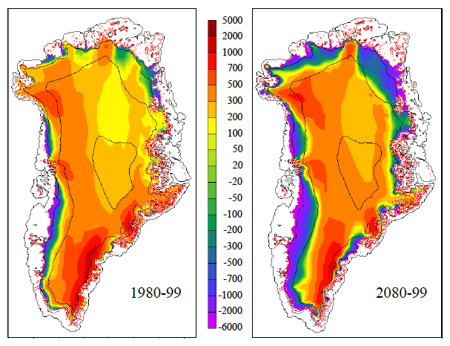
Negative 21st century mass balance for the Greenland ice sheet
Objective
Use the Community Earth System Model (CESM) with a new ice sheet component to project 21st century changes in the surface mass balance (SMB) of the Greenland ice sheet.
Research
Ran coupled CESM simulations with the RCP8.5 (high-emission) scenario using a new multi-category SMB scheme for the Greenland ice sheet
Found that the SMB decreases from 372 ± 100 Gt/yr in 1980-99 to -78 ± 143 Gt/yr in 2080-99
Surface melting doubles and ablation zone expands from 9% to 28% of area, offsetting a modest snowfall increase
Greenland ice sheet mean SMB (mm/yr) simulated by CESM: (a) 1980-99, (b) 2080-99, with the RCP8.5 forcing scenario.
Impact
First projections by a global climate model with a realistic surface-mass-balance simulation of the Greenland ice sheet
Negative SMB by 2100 implies long-term decay of the ice sheet, even without iceberg calving
Reference: Vizcaíno, M., W. H. Lipscomb, W. J. Sacks, and M. van den Broeke (2013), Greenland surface mass balance as simulated by the Community Earth System Model. Part II: 21st century changes, J. Climate, doi:10.1175/JCLI-D-12-00588.1.
Notes:
Wanda says that this is a general slide with no specific reference

