Slide 1
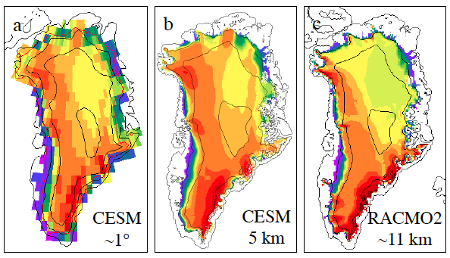
Greenland surface mass balance in the Community Earth System Model
Objective
Validate the surface mass balance (SMB) simulated for Greenland in the Community Earth System Model (CESM) for 1850-2005, using a new SMB scheme developed for ice sheets.
Research
Evaluated a multi-category SMB scheme for the Greenland ice sheet
SMB computed in land model, downscaled to 5-km ice sheet grid, and compared to RACMO2 regional climate model
CESM can realistically simulate Greenland SMB and surface climate, including ablation zones and snowfall maxima
Greenland ice sheet mean SMB (mm/yr), 1960-2005: (a) on CLM grid, (b) downscaled to ice sheet grid, (c) from RACMO2.
Impact
First use of a global climate model to generate a realistic surface mass balance for forcing a dynamic ice sheet model
Success attributed to sophisticated snow model, multiple elevation classes for downscaling, and lack of large climate biases
Reference: Vizcaíno,M., W. H. Lipscomb, W. J. Sacks, J. H. van Angelen; B. Wouters; M. R. van den Broeke (2013), Greenland surface mass balance as simulated by the Community Earth System Model. Part I: model validation and 1850-2005 results, J. Climate, doi:10.1175/JCLI-D-12-00615.1.
Notes:
Wanda says that this is a general slide with no specific reference

