Slide 1
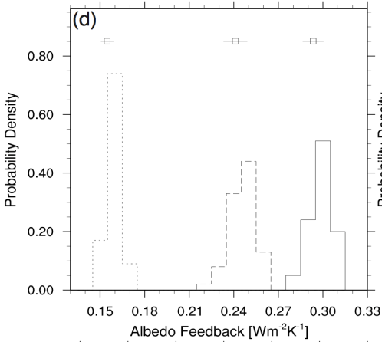
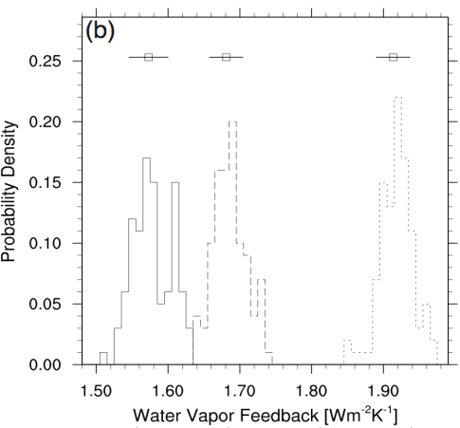
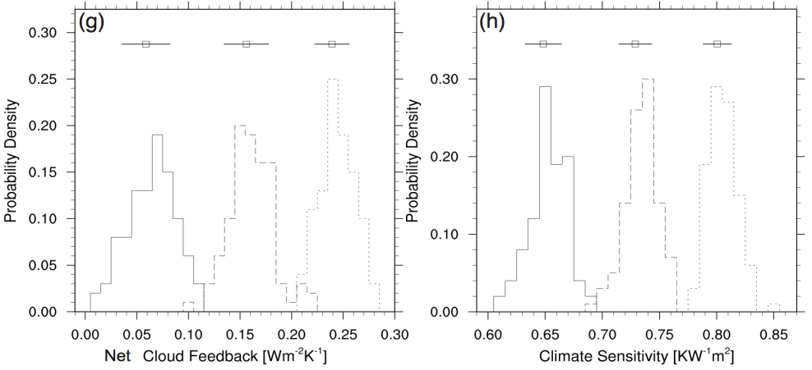
Variations of CCSM3 Feedbacks with CO₂ Forcing
(a)
Objective
Evaluate impact of forcing magnitude on individual feedbacks and climate sensitivity
Investigate role of model ocean dynamics in such analyses
Approach
Compare feedbacks and climate sensitivity from
1450 years of fully coupled simulations with CCSM3 and
60 years of slab ocean simulations with CAM3
each forced with 3 consecutive doublings of CO₂ concentrations
Feedback evaluation method: radiative kernel technique
(c)
(d)
Impact/Results
2xCO₂ – CNTL
4xCO₂ – 2xCO₂
8xCO₂ – 4xCO₂
Climate sensitivity in both model versions increases by >20%
between 2xCO₂ – CNTL and 8xCO₂ – 4xCO₂
Due to increases in positive water vapor and cloud feedbacks
These results contradict other studies, emphasizing the danger in
using only one GCM
Figure: Histograms of feedbacks and climate sensitivity, for the three CO₂ doublings. 30-year running averages for model years 431–1450. Boxes above the histograms represent sample means, and error bars to either side of boxes are standard deviations.
Jonko, A., K. Shell, B. Sanderson and G. Danabasoglu, 2013: Climate Feedbacks in CCSM3 under Changing CO₂ Forcing. Part II:
Variation of Climate Feedbacks and Sensitivity with Forcing, J. Clim, 26, 2784 – 2795.

