Slide 1
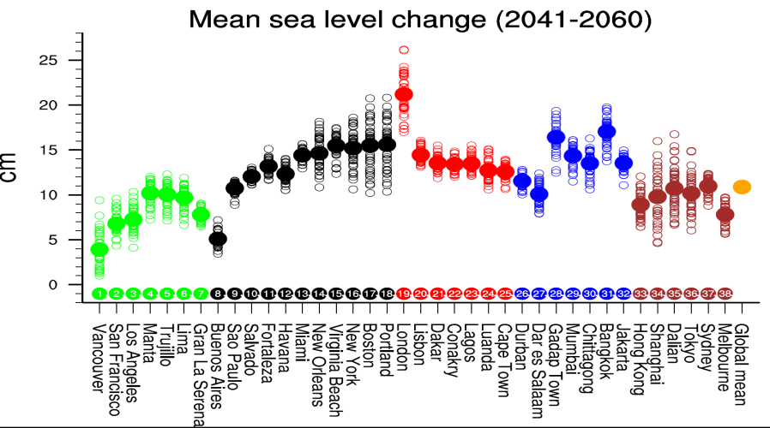
Uncertainty in future regional sea level rise due to internal climate variability
Objective
Sea level rise (SLR) is an inescapable consequence of increasing greenhouse gas concentrations, with potentially harmful effects on human populations in coastal and island regions. Observational evidence indicates that global sea level has risen in the 20th century, and climate models project an acceleration of this trend in the coming decades. Here we will assess the uncertainty in the projected regional SLR due to the internal climate variability alone using a 40-member ensemble simulations of CCSM3.
Simulated change in sea level (cm) between the periods 2041-2060 and 1980-1999 at selected coastal cities from the 40-member CCSM3 ensemble
Approach
Impact
Each of the 40 ensemble members begins at the end of the same 20th century CCSM3 simulation, and is subject to the identical GHG, stratospheric ozone, solar, and aerosol forcings during 2000-2060. In these simulations, the initial ocean, sea ice and land states are identical, but the initial atmospheric conditions are perturbed by selecting atmospheric states on different days between December 1999 and February 2000 from the 20th century simulation.
Our results show that the simulated regional SLR at mid-century can vary by a factor of two depending on location, with the North Atlantic and Pacific showing the greatest range. This uncertainty in regional SLR results primarily from internal variations in the wind-driven and buoyancy-driven ocean circulations. And this uncertainty can not be reduced from improving the model physics and numerics. Thus the policy maker should be aware the potential uncertainty in projected regional SLR.
Reference: Hu, A., and C. Deser, 2013, Uncertainty in future regional sea level rise due to internal climate variability, Geophys. Res. Lett., 40, 2768-2772, doi:10.1002/grl50531.

