Slide 1
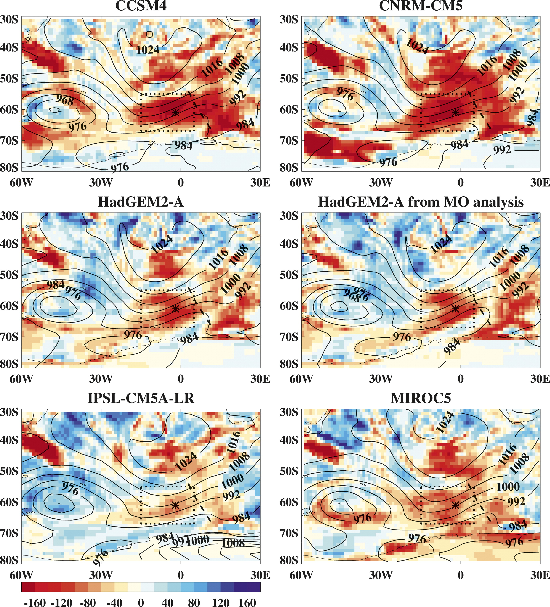
The Transpose-AMIP II Experiment and Its Application to the Understanding of Southern Ocean Cloud Biases in Climate Models
OBJECTIVE
The Transpose-AMIP II experimental design is presented. An example of the type of analysis that may be undertaken using these diagnostics is illustrated through a study of the development of cloud biases over the Southern Ocean, a region that is problematic for many models.
APPROACH
A cyclone compositing method is applied to establish cloud biases in each model. A large negative bias in shortwave radiation on the cold-air side of cyclones emerges in the hindcasts, indicating that the bias is associated with fast processes. A case study is presented comparing a representative cyclone in the models and observations.
IMPACT
The negative shortwave bias is shown to be present primarily on the cold-air side of cyclones and/or leading side of transient ridges, away from frontal regions. The bias is present when the lower troposphere is more stable, but it can be associated with a range of low-level wind speeds. Investigation of the TAMIP2 hindcasts for the case study has revealed that the bias develops quickly (within the first day) and is primarily due to the cloud being too optically thin, with an additional contribution from the cloud fraction being too low in some models. It appears that the overly thin stratocumulus is associated with the inversion being quickly lowered at the beginning of the hindcast and a physically thinner cloud layer being produced.
A 24h mean bias in shortwave flux w.r.t. CERES-Flashflux for 17/1/2009 in hindcasts initialized at 0600 UTC 16/1/2009. Contours show MSLP at 1200 UTC 17/1/2009 (8-hPa intervals). Dotted box/asterisk mark a region/point analyzed in this study. Dashed line marks the A-Train overpass at approximately 1420 UTC 17/1/2009.
K. D. Williams, A. Bodas-Salcedo, M. Déqué, S. Fermepin, B. Medeiros, M. Watanabe, C. Jakob, S. A. Klein, C. A. Senior, and D. L. Williamson, J. Climate, 26, 3258–3274. doi: http://dx.doi.org/10.1175/JCLI-D-12-00429.1

