Slide 1
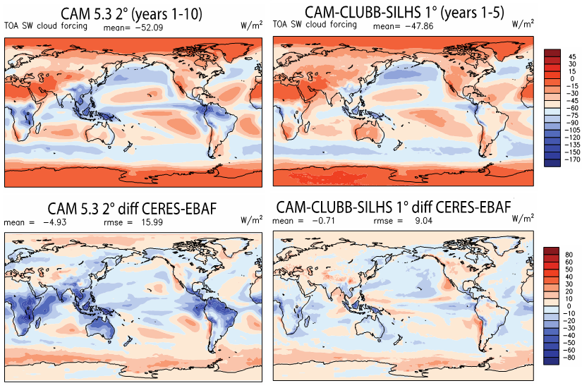
A Unified Cloud Parameterization
Science Question
Can all clouds be explained by the same set of equations?
Approach
Extend a turbulence-cloud scheme to the whole troposphere.
Use random sampling of subcolumns to account for the diversity of cloud properties and processes within model grid cells.
Key Accomplishment
Improved cloud simulation by a unified cloud parameterization.
Mean (top row) and bias compared with observations (bottom row) of solar cloud radiative forcing simulated with unified cloud scheme (right) and combination of three cloud schemes (left)
Thayer-Calder K, A Gettelman, C Craig, S Goldhaber, PA Bogenschutz, C-C Chen, H Morrison, J Höft, E Raut, BM Griffin, JK Weber, VE Larson, MC Wyant, M Wang, Z Guo, and SJ Ghan. 2015. “A Unified Parameterization of Clouds and Turbulence using CLUBB and Subcolumns in the Community Atmosphere Model.” Geoscientific Model Development 8: 3801–3821. DOI:10.5194/gmd-8-3801-2015.
Notes:
http://www.pnnl.gov/science/highlights/highlights.asp?division=749

