Slide 1
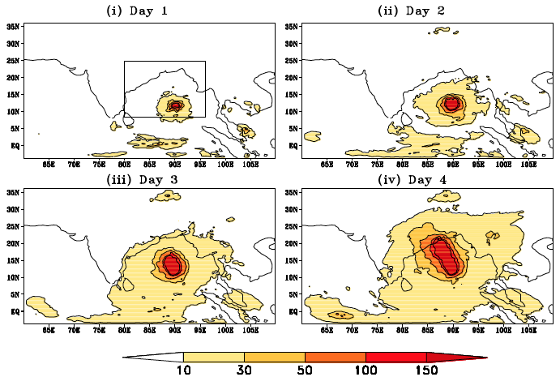




The Role of Moist Processes in the Intrinsic Predictability of Indian Ocean Cyclone
Objective
Identify the predictability limit and the mechanism for the error cascades across spatial scales for Indian Ocean tropical cyclones
Approach
Simulate four tropical cyclones in the Bay of Bengal using WRF v3.4 at 30km, 10km and 1.1km horizontal resolutions
Perform identical twin perturbation experiments at the three resolutions to quantify the model errors at each resolution
Estimate the predictability using the “error doubling time”
Analyze and elucidate the error cascades across spatial scales using different techniques such as power spectrum and scale separation and using numerical experiments
Error growth starts from the region of convection on Day 1 and cascades to significant larger scale errors on Day 4
Impact
Found that buoyancy associated with moist convection plays a major role in intrinsic error growth that limits the intrinsic predictability of tropical cyclones
Demonstrated that errors start to build up from regions of convection and ultimately affects the larger scales through upscale cascades of errors
Taraphdar, S., P. Mukhopadhyay, L. R. Leung, F. Zhang, S. Abhilash and B.N. Goswami. 2014. “The role of moist processes in the intrinsic predictability of Indian ocean cyclone”, J. Geophys. Res. Atmos., 119, doi:10.1002/2013JD021265.

