Slide 1
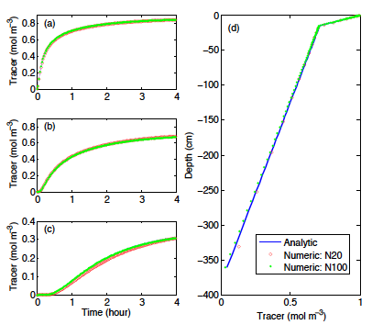
Simple formulations and solutions of dual-phase diffusive transport for biogeochemical modeling
Objective
This paper aimed to propose a simple, accurate, and robust numerical representation of dual-phase diffusion of dissolvable volatile gases in variably saturated soil.
Benchmark against analytical solutions
Research
By formulating the dual-phase diffusion into three equivalent forms, we solved the gas-primary form using the finite volume method. We benchmarked our algorithm against three analytical solutions of steady-state and transient scenarios common in land biogeochemical modeling.
Impact
The new formulation and its solution standardize the representation of dual-phase diffusion for multiple volatile tracers. The approach is now integrated in the CLM4.5-BeTR code and will be part of the next released version of the land model (CLM5).
Reference: Tang, J. Y. and Riley, W. J.: Technical Note: Simple formulations and solutions of the dual-phase diffusive transport for biogeochemical modeling, Biogeosciences, 11, 3721-3728, doi:10.5194/bg-11-3721-2014, 2014.

