Slide 1
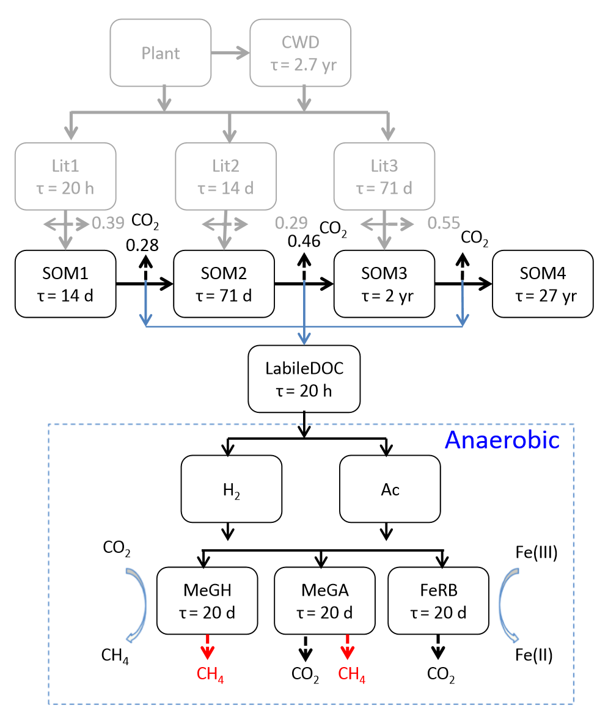
Explicit aqueous phase redox and pH dynamics added to the Converging Trophic Cascade (CTC) decomposition model
Contact: Peter Thornton, 865-241-3742, thorntonpe@ornl.gov
Funding: DOE Office of Science, BER, Terrestrial Ecosystem Science and Earth System Modeling programs
Objective
Combine geochemical and biological modeling components to describe the production of CO₂ and CH₄ in warmed Arctic soils.
Evaluate alternative representations of temperature and pH sensitivity for the coupled biological-geochemical system
New Science
Extend CTC to include simple substrates (sugars and organic acids), Fe(III) reduction, and methanogenesis, while accounting for gas-, aqueous-, and sorbed-phase speciation.
Mechanistic description of pH buffering by organic matter (using WHAM).
All reactions (CTC, WHAM, etc) integrated using the PHREEQC framework
Significance
The extended model captures pH dynamics reasonably well in Arctic soil incubations.
Temperature and pH sensitivity for microbial reactions is highlighted as an important area for further research.
Citation
Tang, G., J. Zheng, X. Xu, Z. Yang, D.E. Graham, B. Gu, S. Painter, P.E. Thornton, 2016. Biogeochemical modeling of CO₂ and CH₄ production in anoxic Arctic soil microcosms. Biogeosciences, 13, 5021-5041. doi:10.5194/bg-13-5021-2016.

