Slide 1
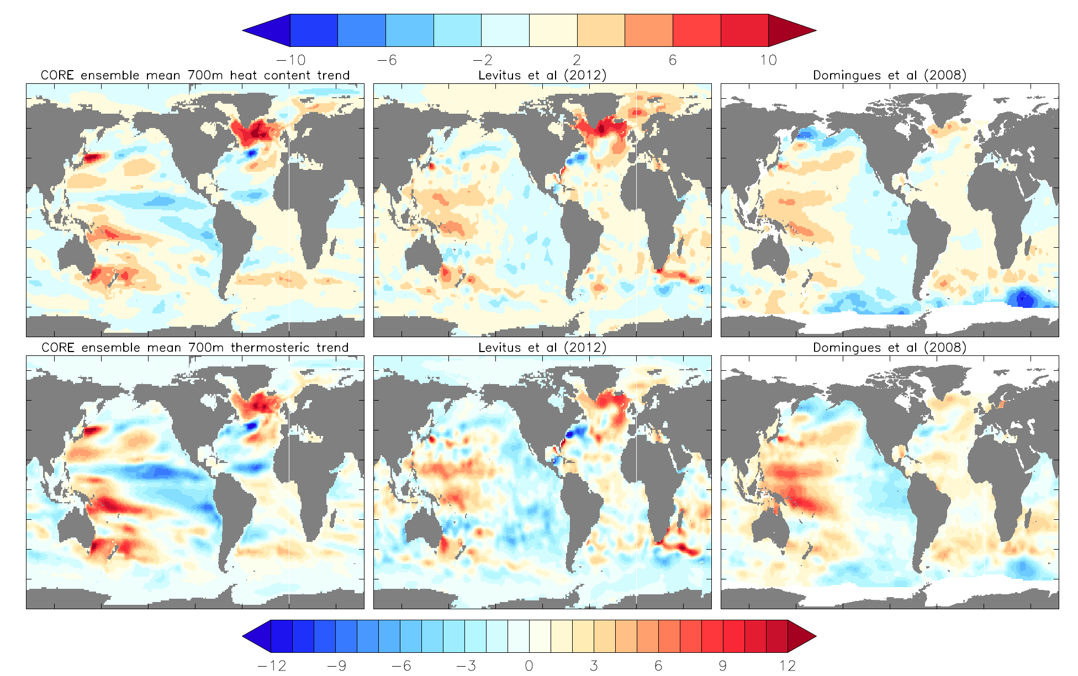
Steric Sea Level in CORE-forced Simulations
Objective
Assess the linear trend in CORE-II simulated dynamic sea level over years 1993-2007, which is dominated by the trend in steric sea level.
Approach
To illustrate changes in the steric patterns, we plot the linear trend in heat content over the upper 700m of ocean (upper panels), and the trends in thermosteric sea level (lower panels) compared to observations.
Impact
To leading order, models capture the linear trend in steric sea level compared to observations.
The thermosteric trends largely reflect the heat content trends, but with some modulation from the thermal expansion coefficient.
The models show a general cooling trend in the tropical northern hemisphere for the Atlantic and Pacific, with a westward extension in this simulated trend absent from both of the observational analyses.
To leading order, models capture the observed warming of the central-west Pacific found in both observation-based analyses, as well as the strong warming in the subpolar North Atlantic as found in Levitus et al. (2012).
Griffies, Stephen M., and coauthors, 2013: Global and regional sea level in a suite of interannual CORE-II hindcast simulations: a synopsis. Exchanges, 18, 11-15.

