Slide 1
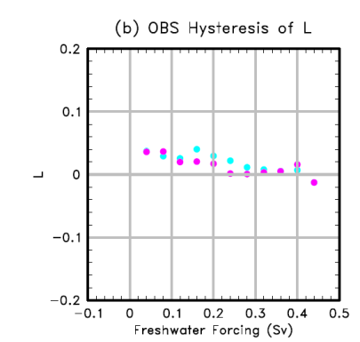
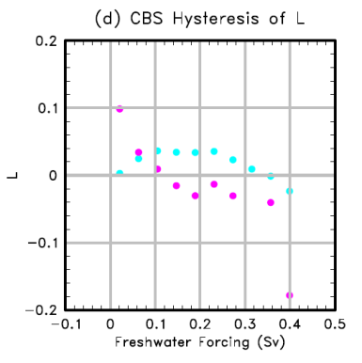
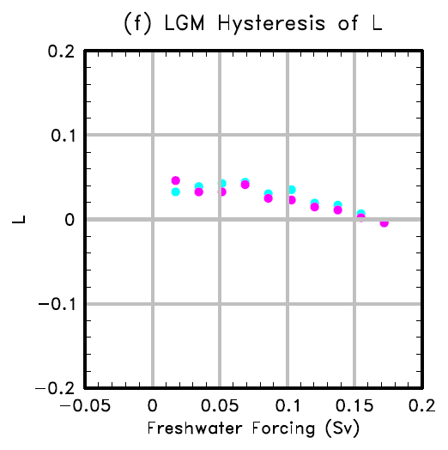
The stability of an evolving Atlantic meridional overturning circulation
Objective
Previous studies have related the meridional freshwater transport in the Atlantic to the Atlantic meridional overturning circulation (AMOC) under equilibrium states. Under global climate changes, the climate state is constantly evolving. To more accurately represent the AMOC, we propose a generalized stability indicator L for a slowly evolving and quasi-steady AMOC, which represents a feedback related to the AMOC and its associated freshwater transport within the Atlantic basin.
Hysteresis diagrams of L in the (b) OBS, (d) CBS and (f) LGM simulations. Positive only suggests AMOC does not have hysteresis.
Approach
Impact
We analyzed the hysteresis simulations using CCSM3 under present day and last glacial maximum background climate conditions using the previously proposed meridional freshwater transport index. Then we derived a new index L to properly take into account the non-stationary change of AMOC, such as the melting of ice sheets will induced a large net freshwater flux into the Atlantic, thus affecting the AMOC variations.
Our results show that this new generalized indicator L can properly represent the changes of the AMOC throughout a full hysteresis cycle. A positive L represents an AMOC has only one equilibrium state. This L also has great implications for the paleoclimate studies. By using the indicator L, we can diagnose the AMOC stability over a certain slowly evolving period in the past climate to understand the subsequent abrupt climate change due to instability of the circulation.
Reference: Liu, W., Z. Liu, A. Hu, 2013, The stability of an evolving Atlantic meridional overturning circulation. Geophys. Res. Lett., doi:10.1029/2013GL055288, in press.

