Slide 1
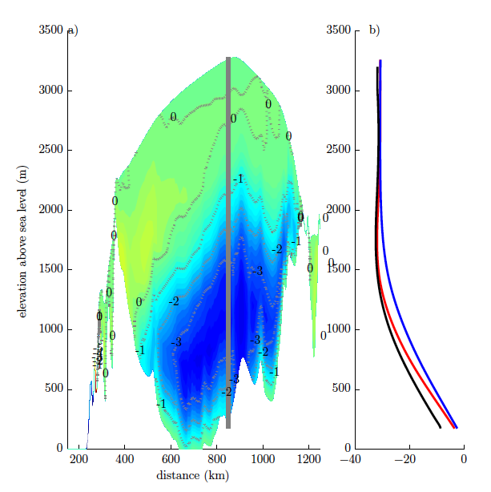
A technique for generating consistent ice sheet initial conditions for coupled ice-sheet/climate models
Objective
Coupled ice-sheet/climate models require a suite of self-consistent restarts for climate change simulations that include an internal ice sheet memory of past climate. Here we develop a technique to generate an ice sheet model initial condition that satisfies these constraints.
Approach
Used glacial, mid-Holocene and preindustrial climate simulations to create end-member ice sheet forcings
Interpolated between end-members using ice-core-derived weighting, to drive long transient CISM simulation
Assessed improvement of transient spin-up approach relative to standard equilibrium spin-up simulation
Impact of transient spin-up technique on internal Greenland Ice Sheet temperatures. The blue region highlights the more accurate portrayal of cold interior ice due to incorporation of a transient climate history in the spin-up procedure.
Impact
Transient spin-up improved internal ice sheet state from incorporation of past climate history, but also remained consistent with simulated climate forcing. This spin-up approach is thus able to generate self-consistent ice-sheet/climate restart conditions for coupled simulations.
Fyke, J.G., W.J. Sacks, W.H. Lipscomb (2014): A technique for generating consistent ice sheet initial conditions for coupled ice-sheet/climate models. Geoscientific Model Development, doi: 10.5194/gmdd-6-2491-2013.

