Slide 1
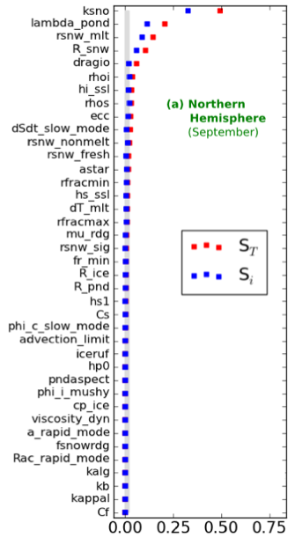
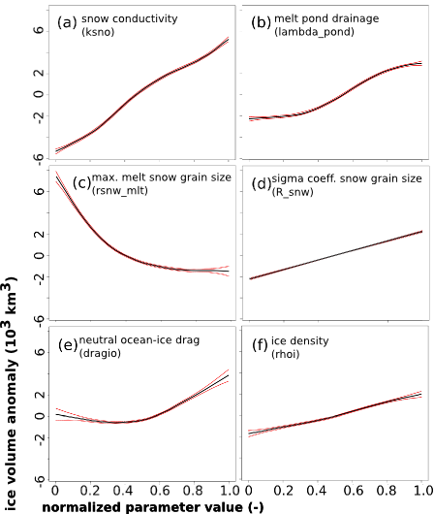
Quantifying uncertainty and sensitivity in sea ice models
Objective
The Los Alamos Sea Ice model has a number of input parameters for which accurate values are not always well established. We conduct a variance-based sensitivity analysis of hemispheric sea ice properties to 39 input parameters. The method accounts for non-linear and non-additive effects in the model.
Approach
Sample entire high dimensional parametric space using Sobol’ sequences and fitting a fast statistical emulator for sea ice volume, area, and extent.
Determine sensitivity indices (main and total effects) from variance decomposition and apportion output uncertainty to input parameters.
Determine main effects and second order interactions using generalized additive models.
Total and main effects indices of minimum ice volume in the Northern Hemisphere.
Main effects indicating first order functional relationships between parameters and September sea ice volume.
Impact
We identified the most important parameters driving uncertainty in CICE (standalone mode), and determined non-linear and non-additive functional relationships with hemispheric sea ice quantities. The results are useful to guide research and calibration activities.
Urrego-Blanco, J. R., N. M. Urban, E. C. Hunke, A. K. Turner, and N. Jeffery (2016), Uncertainty quantification and global sensitivity analysis of the Los Alamos sea ice model, J. Geophys. Res. Oceans, 121, 2709–2732, doi:10.1002/2015JC011558.

