Slide 1
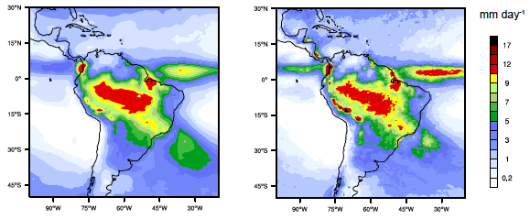
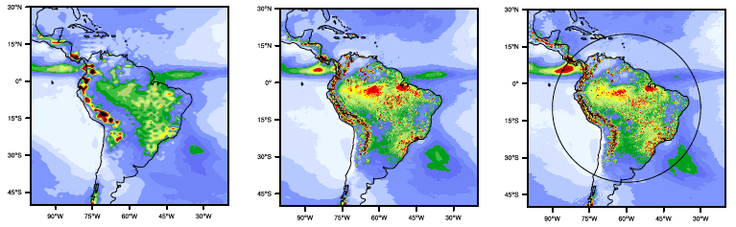
Global, Multi-resolution Model Shows Promising Results for Regional Climate Simulations
Objective
Evaluate the usefulness of a multi-resolution climate model, the Model for Prediction Across Scales - Atmosphere (MPAS-A), for regional climate simulations
Approach
Comprehensive evaluation of a series of decadal simulations at different grid resolutions: globally high-resolution (30km grid cells), globally low-resolution (120km), and multi-resolution simulations (30km grid over a particular region and 120km grid elsewhere).
Model evaluation includes precipitation, surface energy exchange, and atmospheric circulations
GPCP (obs)
TMPA (obs)
MPAS-A, 120km
MPAS-A, 30km
MPAS-A, 120 to 30km*
Comparison of wet-season precipitation over S. America between the observational data sets (top row) and MPAS-A simulations at three resolutions (bottom). *30km grid inside the circle transitioning to 120km outside
Impact
Climate prediction at regional scales requires higher resolution while global simulation is necessary to allow the interactions with the target region and the rest of Earth. MPAS-A shows some promise of achieving both at reduced computational costs.
Sakaguchi K, LR Leung, C Zhao, Q Yang, J Lu, S Hagos, SA Rauscher, L Dong, TD Ringler, and PH Lauritzen. 2015. “Exploring a Multi-resolution Approach using AMIP Simulations.” Journal of Climate, early online. DOI: 10.1175/JCLI-D-14-00729.1
Notes:
http://www.pnnl.gov/science/highlights/highlights.asp?division=749

