Slide 1
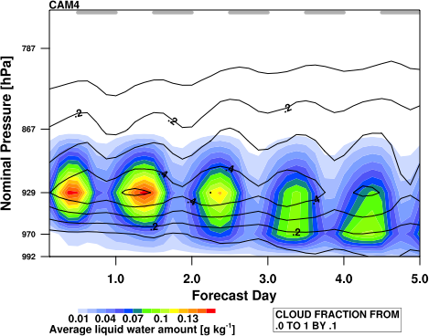
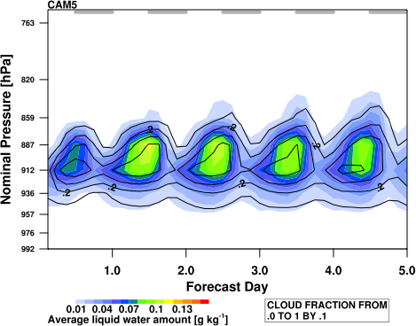
Southeast Pacific stratocumulus in the Community Atmosphere Model
Objective
The subtropical stratocumulus decks are important climatological features that have a strong impact on the TOA radiation balance. These clouds are thin, bright, and form beneath a sharp inversion, and they are notoriously difficult simulate in climate models. This study seeks to evaluate the southeast Pacific stratocumulus in CAM4 and CAM5, focusing on the fast processes associated with the cloud and turbulence parameterizations.
Approach
Use CAPT framework to generate 5-day forecasts of October 2006, save high-frequency output over the southeast Pacific.
Sample stratocumulus based on lower-tropospheric stability.
Use condensate budget terms to examine sources and sinks of cloud water.
Impact
The CAM5 physics more realistically capture the structure of stratocumulus; CAM4 has fundamental shortcomings that lead to shallow boundary layers and poor representation of the vertical structure of the lower troposphere.
Despite the improvement, CAM5 southeast Pacific stratocumulus show an overly strong diurnal cycle, most likely due to the cloud layer decoupling from the boundary layer in the daytime.
The strong diurnal cycle is likely to be partly responsible for subtropical stratocumulus decks dissipating too close to continents, leading to climatological biases.
Ensemble forecasts of stratocumulus vertical structure in (top) CAM4 and (bottom) CAM5. Colors show liquid water content, contour lines show cloud fraction. Gray bars along the top show sunlit hours.
Medeiros, B., D.L. Williamson, C. Hannay, and J.G. Olson (2012), Southeast Pacific stratocumulus in the Community Atmosphere Model, J. Climate, 10.1175/JCLI-D-11-00503.1, in press.

