Slide 1
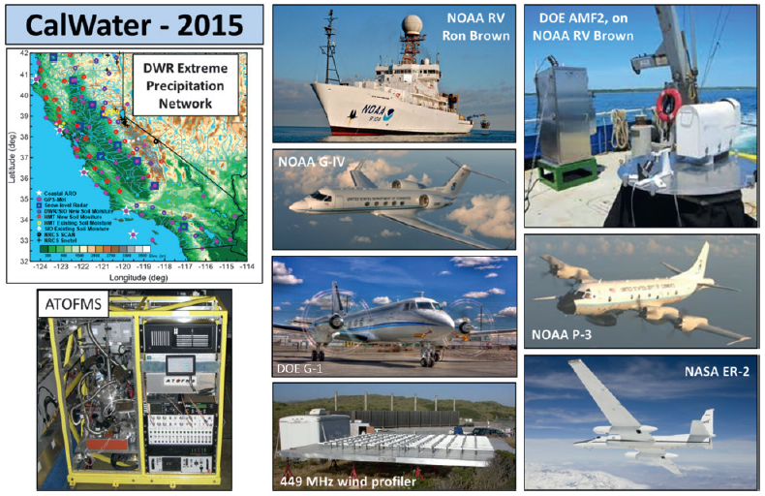
An Interdisciplinary Research Effort Explores the Causes of Variability of Rainfall, Flooding and Water Supply along the U.S. West Coast
Objective
Summarize the major milestones, specific science questions, key results and accomplishments, and future directions of CalWater, a multiyear program of field campaigns, numerical modeling experiments, and scientific analysis focused on phenomena that are key to the water supply and associated extremes in the U.S. West Coast region
Approach
Describe the coupled modeling-observational strategy and the major milestones of CalWater-1 (2008 – 2014) and CalWater-2 (2015 – 2018)
Describe the science gaps and science questions
Highlight key results from studies on atmospheric rivers and aerosol effects on clouds and precipitation and introduce the CalWater-2015 field campaign sponsored by NOAA, DOE, NSF, NASA, California Department of Water Resources and Naval Research Laboratory
Discuss a vision and future directions
Major observing facilities and mobile platforms for CalWater-2015 (12 Jan–8 Mar 2015)
Impact
The CalWater program of studies has advanced understanding of atmospheric rivers and aerosol-cloud-precipitation interactions, with relevancy to regions beyond the U.S. West Coast
CalWater has helped to better quantify the risks associated with climate change.
Ralph FM, K Prather, D Cayan, JR Spackman, P DeMott, M Dettinger, C Fairall, R Leung, D Rosenfeld, S Rutledge, D Waliser, A White, G Franco, J O’Hagan, J Cordeira, A Martin, and J Helly. “CalWater Field Studies Designed to Quantify the Roles of Atmospheric Rivers and Aerosols in Modulating U.S. West Coast Precipitation in a Changing Climate.” Bulletin of the American Meteorological Society 97: 1209–1228. DOI: 10.1175/BAMS-D-14-00043.1
Notes:
http://www.pnnl.gov/science/highlights/highlights.asp?division=749

