Slide 1
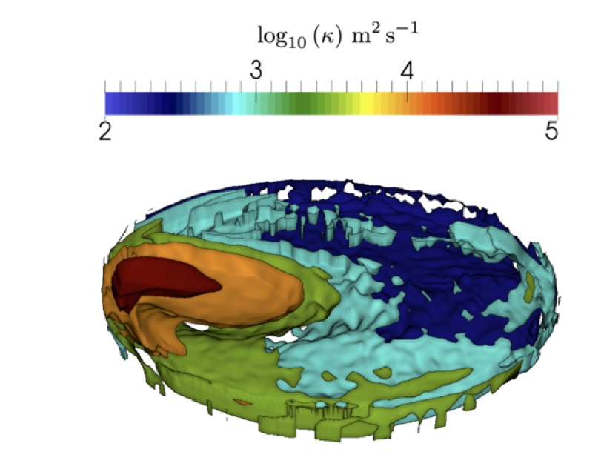
Diagnosing ocean mixing via Lagrangian particle Tracking (LIGHT)
Objective
Diagnose ocean mixing via diffusivity to better understand tracer ventilation and heat transport at high latitude. Diffusivity is also needed to develop improved parameterizations of ocean mixing.
Approach
Developed a Lagrangian In-situ, Global, High-performance particle Tracking (LIGHT) analysis module for MPAS-O ocean component of ACME
Diagnosed diffusivity using LIGHT in Simulating Ocean Mesoscale Activity (SOMA) idealized ocean basin
LIGHT capable of simulating millions of particles, an order of magnitude improvement over other approaches
Three-dimensional calculated structure of diffusivity.
Impact
Development of LIGHT and method to compute diffusivity paves way for global computation of diffusivity within ACME couple-climate simulations. Work will also aid development of scalar closure schemes for eddy-permitting ocean model.
P.J. Wolfram, T.D. Ringler, M.E. Maltrud, D.W. Jacobsen, and M.R. Petersen, 2015. Diagnosing isopycnal diffusivity in an eddying, idealized mid-latitude ocean basin via Lagrangian In-situ, Global, High-performance particle Tracking (LIGHT), Journal of Physical Oceanography, doi: 10.1175/JPO-D-14-0260.1.
Notes:
Wanda says that this is a general slide with no specific reference

