Slide 1

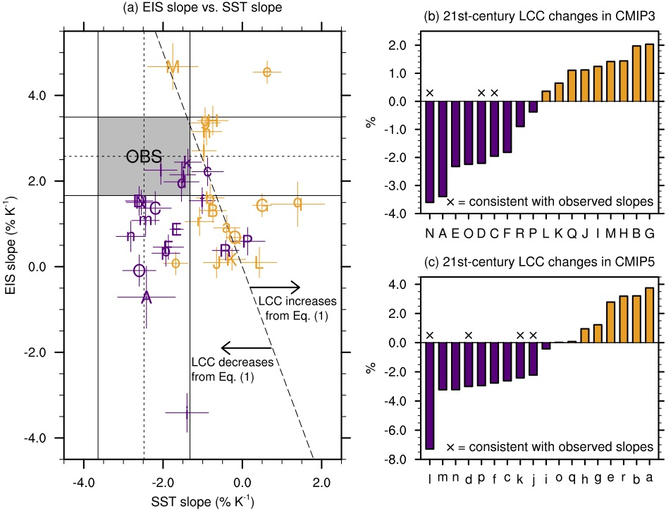
Positive tropical marine low-cloud cover feedback inferred from cloud-controlling factors
Xin Qu, Alex Hall, Stephen A. Klein and Anthony M. DeAngelis
Science Questions:
• What drives the sensitivities of tropical marine low-cloud cover to variations in the strength of tropical inversion and sea surface temperature?
* Can an observed constraint on these sensitivities help constrain future changes in tropical marine low-cloud cover?
The seven models with realistic EIS and SST sensitivities give a range for changes in low-cloud cover, −2 to −4% under the scenario A1B and −3 to −7% under RCP8.5.
Approach:
• The contributions of seven cloud-controlling factors to future changes in tropical marine low-cloud cover were quantified in 36 climate models
These contributions were linked to the contributions of the inversion strength and sea surface temperature.
• Observations were used to constrain the sensitivities of low-cloud cover to the inversion strength and sea surface temperature.
Key Accomplishments:
* The SST contribution corresponds to the sum of two terms, the latent heat flux and vertical moisture gradient.
* The cloud sensitivities to the inversion strength and sea surface temperature are biased in many models (see figure at right).
* Our results support a positive marine low-cloud cover feedback (see figure at right).
Publication:
Qu, X., A. Hall, S. A. Klein and Anthony M. DeAngelis (2015), Positive tropical marine low-cloud cover feedback inferred from cloud-controlling factors. Geophys. Res. Lett.,42, doi:10.1002/2015GL065627.
Notes:
Figure caption: An observed constraint on EIS and SST sensitivities. (a) Scatterplot of the EIS sensitivity versus the SST sensitivity in 36 CMIP3 and CMIP5 models. The associated 5–95% confidence ranges are represented by the whiskers. Estimates of observed EIS and SST sensitivities are shown as the short-dashed lines, and the associated 5–95% confidence ranges are represented by the solid lines. The area within the confidence ranges is shaded in gray. The long-dashed line (y = −2.5x) is composed of all pairs of EIS and SST sensitivities corresponding to zero changes in low-cloud cover (LCC). Most models on the right side of the line exhibit an LCC increase, suggestive of a dominant role by EIS, while most models on the left side of the line exhibit an LCC decrease, suggestive of a dominant role by SST. (b) Simulated 21st century LCC changes averaged over the five main low-cloud regions in 18 CMIP3 models. (c) As in (b) but for 18 CMIP5 models. Models with EIS and SST slopes consistent with observed EIS and SST slopes are marked with the cross in (b) and (c).
Introduction: Projected 21st century changes in marine LCC are known to exhibit a large spread across general circulation models (GCMs), with the sign of the change being either positive or negative. In a previous study, we developed a two-variable heuristic model to interpret LCC changes in 36 climate models. These two variables are the tropical inversion strength (measured by the estimated inversion strength, EIS) and sea surface temperature (SST). The main goal of this paper is to elucidate the processes underlying LCC sensitivities to EIS and SST variations and develop a method to constrain them observationally.
Results and Conclusion: Here we show that in models the feedback is mainly driven by three large-scale changes—a strengthening tropical inversion, increasing surface latent heat flux, and an increasing vertical moisture gradient. Variations in the LCC response to these changes alone account for most of the spread in model-projected 21st century LCC changes. A methodology is devised to constrain the LCC response observationally using SST as a surrogate for the latent heat flux and moisture gradient. In models where the current climate’s LCC sensitivities to inversion strength and SST variations are consistent with observed, LCC decreases systematically, which would increase absorption of solar radiation. These results support a positive LCC feedback. Correcting biases in the sensitivities will be an important step toward more credible simulation of cloud feedbacks.

