Slide 1
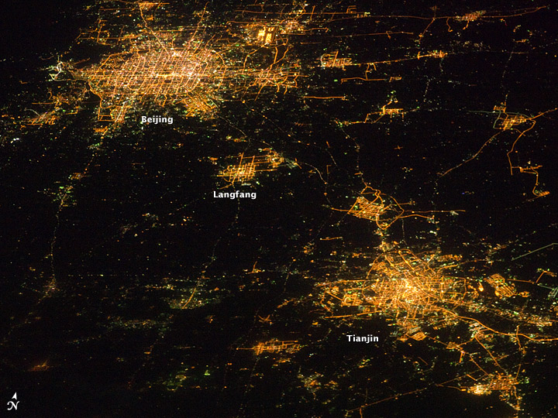
Urbanization Impact on Summer Precipitation: Urban Heat Island Versus Aerosol Effects
Objective
Understand and quantify the relative contributions to precipitation from the urbanization-induced concurrent urban heat island and aerosol effects
Approach
Perform convection-resolving ensemble simulations using the WRF-Chem model coupled with a single-layer Urban Canopy Model (UCM)
Use high-resolution satellite nightlight images to re-grid and obtain high-resolution urban area data and correct emission data
Night-light satellite image over Greater Beijing Metropolitan Area
Impact
Urbanization-induced urban expansion and aerosol particle’s increase have opposite effects on precipitation processes
Aerosol particles suppress/enhance convection and rainfall in the upstream/downstream area
The aerosol-cloud interaction effect plays a dominant role in the region by modifying the Beijing rainfall pattern
Zhong S, Y Qian, C Zhao, R Leung, and X-Q Yang. 2015. “A Case Study of Urbanization Impact on Summer Precipitation in the Greater Beijing Metropolitan Area: Urban Heat Island Versus Aerosol Effects.” Journal of Geophysical Research: Atmospheres 120: 10,903–10,914. DOI: 10.1002/2015JD023753
Notes:
http://www.pnnl.gov/science/highlights/highlights.asp?division=749

