Slide 1
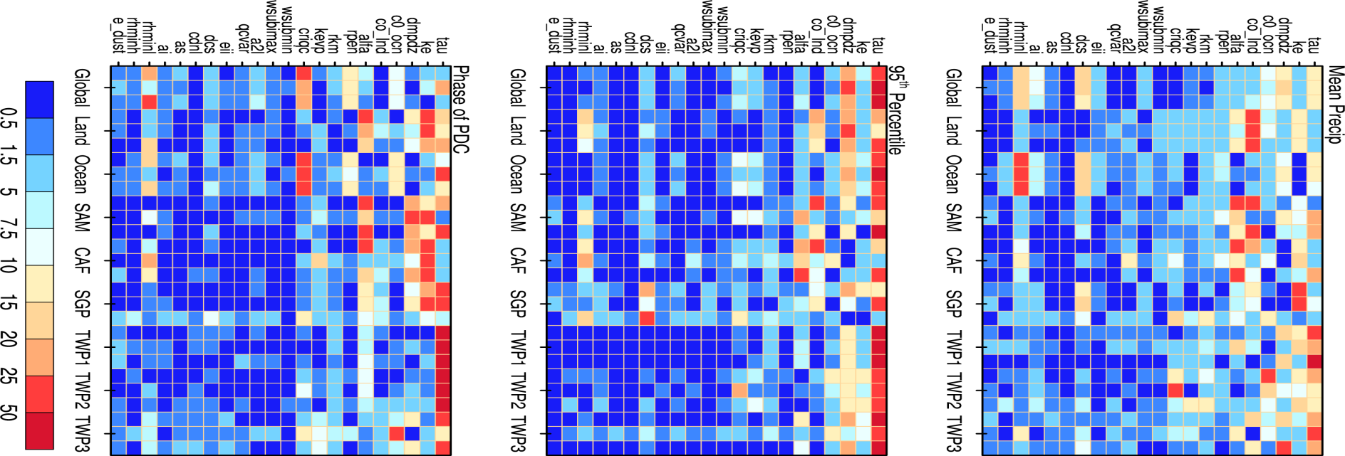

Parametric Sensitivity and Uncertainty Quantification of Precipitation at Global and Local Scales in CAM5
Objective
Identify which CAM5 parameters are most influential on precipitation. Find the sensitivity of precipitation mean, extreme, and diurnal cycle and how the parameters vary by spatial scale, region and season.
Approach
Use two sampling approaches (the Latin hypercube and quasi-Monte Carlo) to effectively explore the high-dimensional parameter space
Conduct two large simulation sets: one set with 1100 simulations for 22 cloud-related parameters and the other set with 256 simulations for aerosol parameters.
Apply a generalized linear model to quantify parametric sensitivity.
Sensitivity of mean precipitation over multiple regions and seasons to each parameter (on y-axis). Three columns for each region (on x-axis) correspond to annual, JJA and DJF mean, respectively. Larger number indicates larger sensitivity.
Impact
Identified six parameters having the greatest influences on global precipitation
Precipitation does not always respond monotonically to parameter change.
Better understanding of CAM5 model behavior associated with parameter uncertainties to guide the next step to reducing model uncertainty in precipitation and developing new parameterizations.
Qian Y, H Yan, Z Hou, G Johannesson, SA Klein, D Lucas, R Neale, PJ Rasch, LP Swiler, J Tannahill, H Wang, M Wang, and C Zhao. 2015. "Parametric Sensitivity Analysis of Precipitation at Global and Local Scales in the Community Atmosphere Model CAM5.“ Journal of Advances in Modeling Earth Systems 07. DOI:10.1002/2014MS000354
Notes:
http://www.pnnl.gov/science/highlights/highlights.asp?division=749

