Slide 1
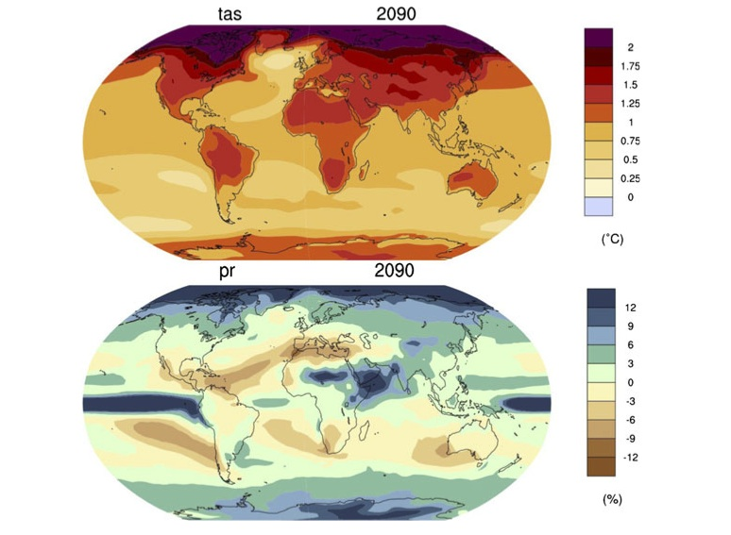
Pattern scaling:
a review of its strengths and limitations,
and an update on the latest model simulations
Objective: We seek to characterize aspects of robustness and variability for patterns of temperature and precipitation change across models, scenarios and CMIP phases. Thus we want to highlight robust features that give confidence in models’ simulation of future changes and to identify sources of uncertainty.
Approach: We use the latest transient simulations from all scenarios and models available in CMIP5, and those available from CMIP3 and computing patterns of change normalized per degree of global warming, so to allow comparison across models and scenarios. We analyze the robustness of multi-model mean patterns and compare model to scenario uncertainty, to determine which is more relevant.
Impact: The robustness of the geographical features in patterns of temperature and precipitation changes, when computed as multi-model means, is confirmed. The intensity of the change (in both the warmer and cooler areas with respect to global temperature change, and the drier and wetter regions) is overall heightened per degree of global warming in the ensemble mean of the new simulations (CMIP5), compared to CMIP3. The presence of stabilized scenarios in the new set of simulations allows investigation of the performance of the technique once the system has gotten close to equilibrium, which we find suboptimal, confirming the idea that patterns under equilibrated conditions tend to differ from patterns estimated during a transient forcing simulation. Overall, the well-established validity of thepattern scaling technique in approximating the forced signal of change under increasing concentrations of greenhouse gases is confirmed.
Patterns of temperature and percent precipitation change per degree of global warming, derived as multi-model means from all models in CMIP5 providing output under RCP4.5, 6 and 8.5
Tebaldi C. and Arblaster, J.M., 2014. Pattern scaling: a review of its strengths and limitations, and an update on the latest model simulations, Climatic Change, 122(3), 459-471. doi: 10.1007/s10584-013-1032-9

