Slide 1
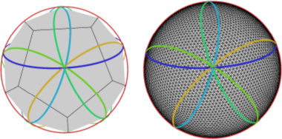
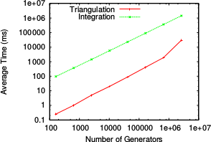
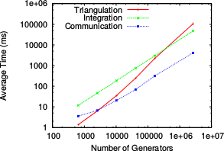
Parallel algorithms for planar and spherical Delaunay construction with an application to centroidal Voronoi tessellations
Top: Images showing the overlapping decompositions in the new algorithm. Bottom left: Timings with standard algorithm: Bottom Right: Timings with new algorithm.
Objective
Techniques for the generation of spherical centroidal Voronoi tessellations are currently computationally demanding due to the serial algorithms employed. In order to create meshes suitable for grand challenge simulations mesh generation tools need to be improved.
Research
Impact
Developed a new algorithm for the parallel construction of Delaunay tessellations.
Employed this new algorithm within a spherical centroidal Voronoi tessellation generator.
Compared new mesh generators performance with a mesh generator using a standard algorithm.
The newly developed algorithm allows faster creation of new variable resolution meshes. In addition to faster mesh generation, the parallelism allows meshes with a larger number of degrees of freedom to be created.
This new algorithm will be used to create more efficient mesh generators for MPAS-based climate models within DOE.
Reference: Jacobsen, D., with Gunzburger, M., Ringler, T., Burkardt, J., Peterson, J., 2013 Parallel algorithms for planar and spherical Delaunay construction with an application to centroidal Voronoi tessellations, Geoscientific Model Development, in press,

