Slide 1
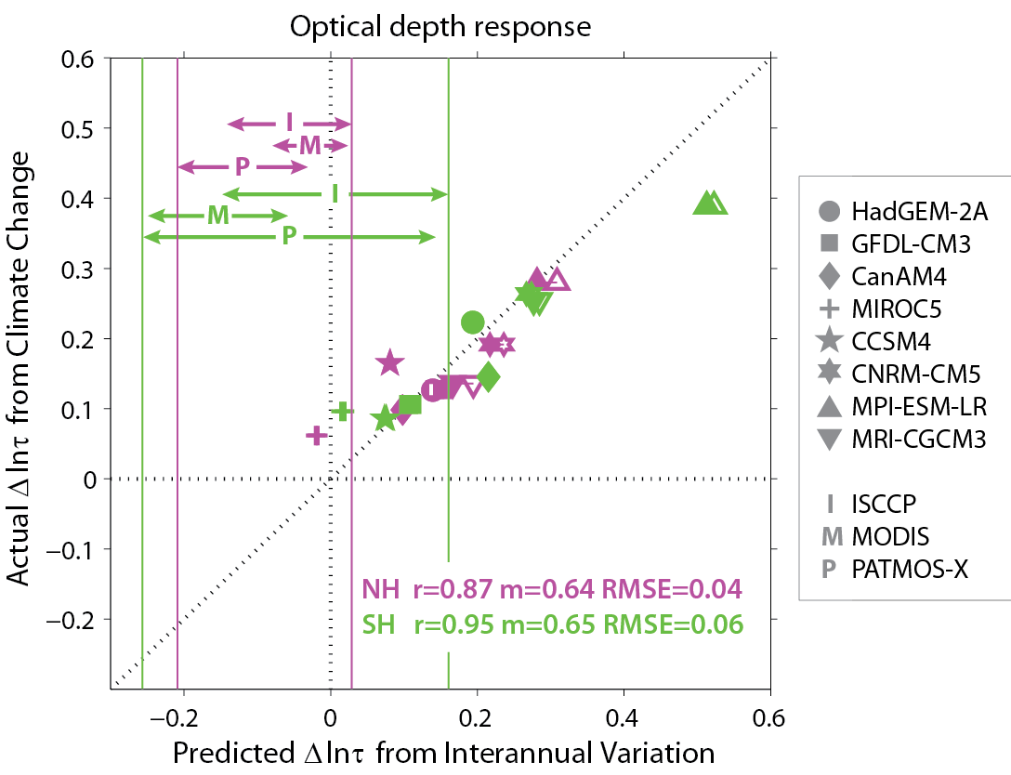
Constraining cloud optical depth feedback with satellites
Objective
Determine how much low-cloud reflectivity will respond to warming (optical depth feedback) in middle and high latitudes
Approach
Compare the response in climate models with satellite observations
Use year-to-year response of cloud optical depth to temperature and stability changes to assess the agreement between models and satellites
Impact
Most climate models likely overestimate the increase in low-cloud reflectivity with anthropogenic climate change and the associated negative feedback
models
satellites
In climate models, actual changes in cloud optical depth due to 4K warming (y-axis) matches well with predictions based on the response of optical depth to changes in year-to-year temperatures (x-axis). Compared to satellite estimates, most models overestimate the increase in optical depth.
Terai, C. R., Klein, S. A. & Zelinka, M. D. Constraining the low-cloud optical depth feedback at middle and high latitudes using satellite observations. J. Geophys. Res. Atmos., 121, doi:10.1002/2016JD025233 (2016).
Notes:
Summary: In most climate models, the optical depth of low-level clouds increases with warming poleward of 40°. Although models agree on the sign, they disagree on the magnitude of this response. Building on previous results that suggest that the cloud response to temperature is timescale invariant for low-level clouds, we examined how well the year-to-year response in cloud reflectivity agreed between climate models and satellite observations. We found that most climate models tended to overestimate the increase in cloud reflectivity with warming. Instead of predicting an increase in cloud reflectivity, satellite-based estimates predict that the low-level clouds become slightly less reflective with warming. Because the year-to-year cloud response in climate models matches the response due to long-term global warming, this result has direct relevance to predicting how clouds will change with greenhouse gas-induced warming. The impact on changes in global temperature is likely small, but the results suggest that local warming in the middle and high latitudes from increased greenhouse gases are underestimated because of this bias in the models.

