Slide 1
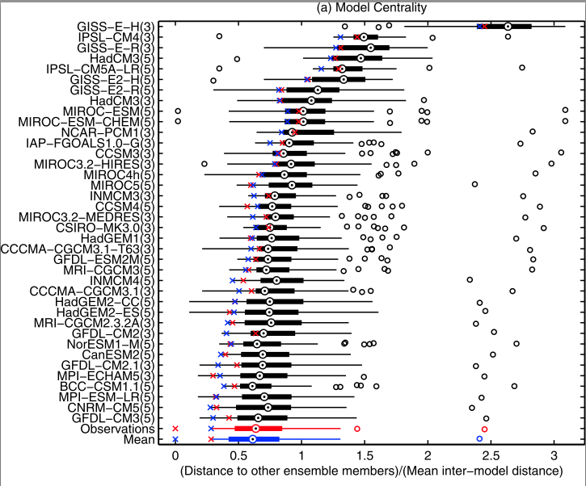
On the interpretation of constrained climate model ensembles
Objectives
Demonstrate how model tuning can lead to the impression of a “truth-centered ensemble”, which might not be the case for future projections
Approach
Use a multi-variate approach to demonstrate that the present-day ensemble mean appears closer to the observations than can be explained by chance.
Impact
Shows that some methodologies for climate parameter estimation may be overconfident if they assume a truth-centered ensemble will continue into the future.
Benjamin M. Sanderson and Reto Knutti, 2013: On the interpretation of constrained climate model ensembles, Geophysical Research Letters,
Volume 39, Issue 16

