Slide 1
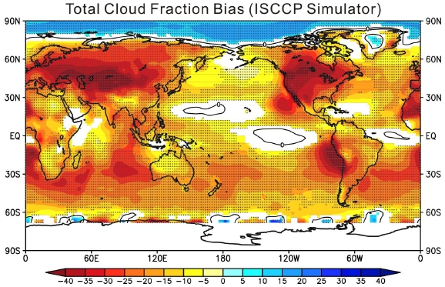
On the correspondence between mean forecast errors and climate errors in CMIP5 models
Ma, H.-Y., S. Xie, S. A. Klein, K. D. Williams, J. S. Boyle, S. Bony, H. Douville, S. Fermepin, B. Medeiros, S. Tyteca, M. Watanabe, and D. Williamson: Journal of Climate. http://dx.doi.org/10.1175/JCLI-D-13-00474.1
OBJECTIVE
This study examines the correspondence between short- and long-term systematic errors in five atmospheric models. The focus is on June-August, though results are expected to hold for other seasons. The comparison allows one to diagnose the time scales over which systematic errors develop, and yields insights into their origin through a seamless modeling approach.
APPROACH
Short-term hindcasts from the Transpose-AMIP II project are compared with AMIP simulations of the same models from the CMIP5 archive. Model errors are diagnosed by comparing with observations and/or reanalysis products. The robustness of errors is investigated using the multi-model mean.
IMPACT
Systematic errors in precipitation, clouds, and radiation processes in the climate simulations manifest in a few days in the hindcasts in all models. This robust bias correspondence suggests that these systematic errors across different models arise from model parameterizations as the large-scale state remains close to observations in the first few days. The biases associated with parameterized physics can feed back on the large-scale state on synoptic time scales, and impact fields such as winds, surface temperature, and sea level pressure. These results suggest that changes to a model to improve hindcasts will likely also improve long-term climate errors.
June-August CMIP5/AMIP multi-model mean total cloud fraction biases from ISCCP simulator (%, color shades), and contours indicate zero bias. Regions where ensemble mean biases are statistically significant at the 95% confidence level are color shaded. The stippled regions are where more than three (including three) out of four transpose-AMIP II models have the same sign of biases on Day 5 compared to CMIP5/AMIP multi-model mean biases.

