Slide 1
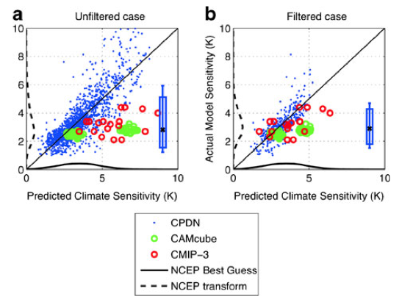
On the estimation of systematic error in regression-based predictions of climate sensitivity
Objectives
Demonstrate overconfidence in previous studies of large scale response using perturbed physics ensembles
Propose methodologies for overcoming these issues using the CMIP3 multi-model archive
Approach
Propose 2 alternative methodologies: a constrained regression approach to overcome bias which arises using non-physical ensemble members, or pre-filtering of the original ensemble
Impact
Very high climate sensitivity models using the Hadley Center HadCM3 models were shown by this study to be unphysical, and to have influenced previous probabilistic studies using that model.
Benjamin M. Sanderson, Climatic Change, June 2013, Volume 118, Issue 3-4, pp 757-770

