Slide 1
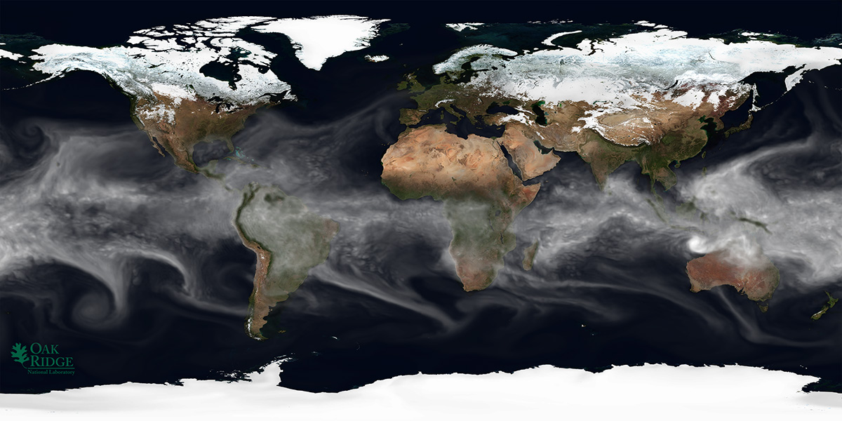
A Case Study of CUDA FORTRAN and OpenACC for an Atmospheric Climate Kernel
Objectives
Impact
Determine the maturity of OpenACC (OACC) compiler implementations for a representative climate kernel compared to CPU and CUDA implementations in terms of (1) bugs and (2) cost.
Determine whether OACC is a viable option for porting ACME to GPUs.
Significant portions of ACME must be ported to accelerators, requiring a directives-based approach. But can directives compete with CUDA in terms of runtime cost?
We now have a quantitative view of OACC’s speed in PGI and Cray implementations, better informing our approach to porting ACME.
Accomplishments
OACC performance about 1.5x slower than CUDA
PGI implementation significantly less mature than Cray
Cannot use FORTRAN derived types, other bugs as well
PGI needs more code transformations to perform well
OACC porting significantly easier and more readable
OACC (particularly Cray) should be suitable for porting
M. Norman, J. Larkin, A. Vose, K. Evans. “A Case Study of CUDA FORTRAN and OpenACC for an Atmospheric Climate Kernel”, In Journal of Computational Science, 9:1-6..
CAM simulation of integrated water vapor, one of many passive tracers transported globally (courtesy, J. Daniel)
Notes:
1

Slide 2
A Case Study of CUDA FORTRAN and OpenACC for an Atmospheric Climate Kernel
Summary
The porting of a key kernel in the tracer advection routines of the Community Atmosphere Model - Spectral Element (CAM-SE) to use Graphics Processing Units (GPUs) using OpenACC is considered in comparison to an existing CUDA FORTRAN port. The development of the OpenACC kernel for GPUs was substantially simpler than that of the CUDA port. Also, OpenACC performance was about 1.5x slower than the optimized CUDA version. Particular focus is given to compiler maturity regarding OpenACC implementation for modern fortran, and it is found that the Cray implementation is currently more mature than the PGI implementation. Still, for the case that ran successfully on PGI, the PGI OpenACC runtime was slightly faster than Cray. The results show encouraging performance for OpenACC implementation compared to CUDA while also exposing some issues that may be necessary before the implementations are suitable for porting all of CAM-SE. Most notable are that GPU shared memory should be used by future OpenACC implementations and that derived type support should be expanded.
M. Norman, J. Larkin, A. Vose, K. Evans. “A Case Study of CUDA FORTRAN and OpenACC for an Atmospheric Climate Kernel”, In Journal of Computational Science, 9:1-6.
Notes:
Location parameter: indicates the position of the distribution of extremes from the origin (.i.e the change in location parameter implies a shift in the distribution of values).
2

