Slide 1
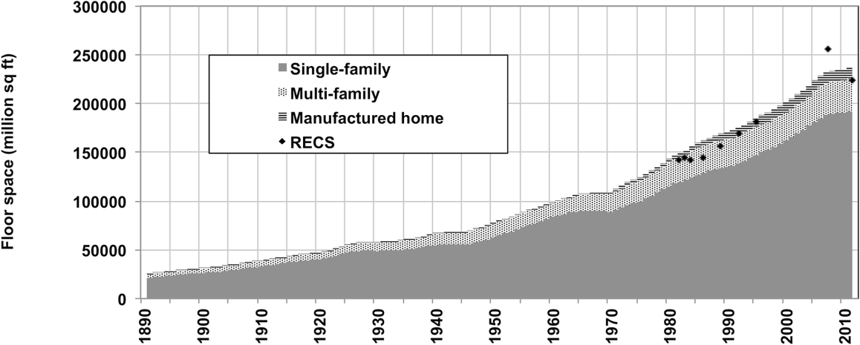
120 Years of U.S. Residential Housing Stock
and Floor Space
Objective
Develop a consistent, long-term historical data set of U.S. housing stock and floor space, disaggregated over building type and age, for use in residential sector energy consumption and energy efficiency modeling.
Approach
Used inventory modeling to estimate housing stock from new construction and retirements.
Employed survival dynamics to disaggregate by building vintage.
Minimized the effect of inconsistency and incompleteness in the survey data.
New U.S. residential sector floor space time-series goes back 120 years and homogenizes survey data
Impact
Residential buildings are a key driver of energy consumption, accounting for 20% of total U.S. energy consumption and energy-related CO₂ emissions.
This new data set will foster advances in the long-term energy and emissions modeling in the U.S. residential sector.
This work showed the importance of household size as a major driver of floor space change over time, and how floor space cannot be assumed to grow at the same rate as population.
Moura MCP, SJ Smith, and DB Belzer. 2015. “120 Years of U.S. Residential Housing Stock and Floor Space.” PLOS ONE. DOI:10.1371/journal.pone.0134135
Notes:
http://www.pnl.gov/science/highlights/highlights.asp?division=749

