Slide 1
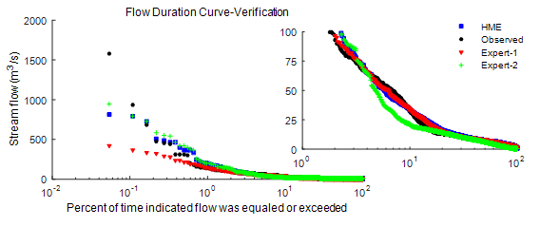
Hierarchical Mixture of Experts and Diagnostic Modeling Approach to Reduce Hydrologic Model Structural Uncertainty
Objective
Provide a modeling framework to integrate hydrological models, which are specialized in simulating the different components of hydrologic al process, by taking into account the uncertainty and dynamic nature of the interactions among the different components
Approach
Model diagnostic analysis using various signature measures, including recession curve, flow duration, and posterior distribution of parameters, to identify model structural uncertainty and suitable hydrological models
Hierarchical Mixture of Experts to adaptively integrate specialized hydrological models depending on dominant hydrologic processes at any given time and spatial location
Flow duration curve showing the observed and predicted streamflow using HME and expert models. The HME coupled Expert 1 (groundwater model) and Expert 2 (runoff model) by providing more weight to Expert 2 following storm events in the catchment and to Expert 1 during no storm period.
Impact
The multiple signature measures introduced in this study not only help to evaluate models’ overall performance but also to diagnose and identify appropriate models or structures.
Provides an adaptive and probabilistic model integration framework to simulate dynamic catchments that are subjected to multiple dominant processes.
The HME framework can easily be extended for other integrated modeling applications.
Moges E, Y Demissie and H Li. 2016. “Hierarchical Mixture of Experts and Diagnostic Modeling Approach to Reduce Hydrologic Model Structural Uncertainty.” Water Resources Research, in press, accepted online. DOI: 10.1002/2015WR018266
Notes:
http://www.pnnl.gov/science/highlights/highlights.asp?division=749

