Slide 1
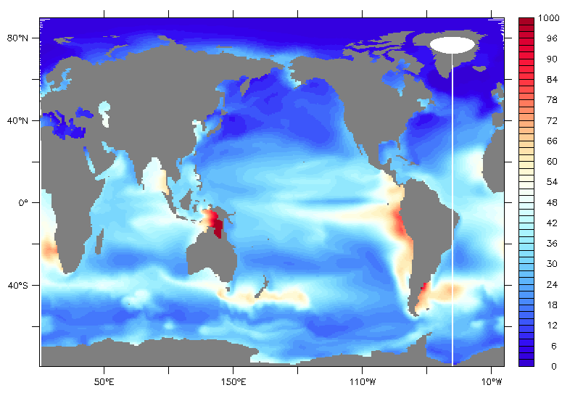
Marine Macromolecules: Planetary Scale 2D Chemistry
Objective
Marine food webs release lipids and biopolymers which quickly coat bubbles, the sea surface & nascent spray. The organics determine spray number fluxes, Kohler CCN effects and gas transfer globally. ACME and HiLAT are the 1st community system models to treat such processes.
Simulation of one biopolymer from among a suite now in ACME, plus available for HiLAT with benchmarking. Left: Neutral sugars in February, micromolar. Second panel represents bubble adsorption processes in CAM spray.
Approach
ACME and MPAS-O distribute the macros via full reactive transport
Source cell disruption then removal by bacteria, free enzymes, photolysis
Adsorption, with multiphases up next
For coupled ESM, full precursor emission feedbacks now within reach
Impact
Estimates of uncertainty from marine biogenic emissions are wide, and climate influence in remote areas strong. We will explore-narrow the range via mechanism development, validation and sensitivity testing in the unique DOE model family.
Latest DOE ESM Chemistry@Interfaces Working Group Pubs: Ogunro, O., Burrows, S., Elliott, S., Moore, K., Russell, L. and 3 others 2015. Global distribution and surface activity of macromolecules in offline simulations of marine organic chemistry. Biogeochemistry, 10.1007/s10533-015-0136-x. McCoy, D. with Burrows, S., Elliott, S. and 4 others. 2015. Natural aerosols explain seasonal and spatial patterns of Southern Ocean cloud albedo. Science Advances 6, 10.1126/sciadv.1500157. Elliott, S., Burrows, S., Deal, C., and 3 others 2014. Simulating macromolecular surfactant chemistry at the ocean atmosphere boundary. Environmental Research Letters 9, 064012. Burrows, S., Ogunro, O., Russell, L., Rasch, P. and Elliott, S. 2014. A physically based framework for modeling the organic fractionation of sea spray aerosol from bubble film Langmuir equilibria. Atmospheric Chemistry and Physics, ACP-2014-32. Frossard, A. with Elliott, S. and 7 others, 2014. Composition of submicron organic mass in marine aerosol particles. Journal of Geophysical Research –Atmospheres, 2014JD021913.

