Slide 1
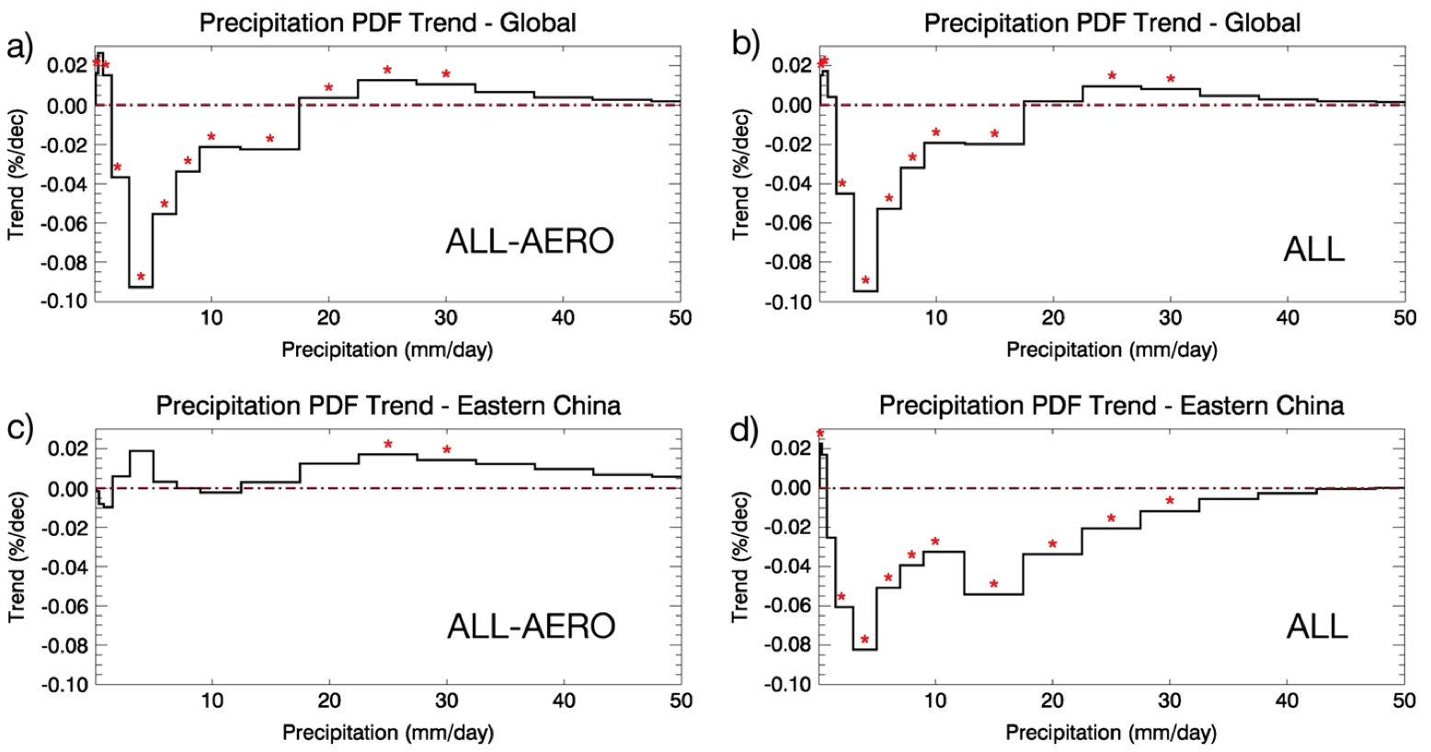
Aerosols Suppress Light Precipitation in China
Global scale:
Aerosol effects not dominant
Objective
Reconcile the influence of air pollution and global warming on precipitation rate changes
Approach
Compare 50-year CAM5 model simulations with 3-hrly precipitation from satellite observations (from TRMM) and monthly averages (from GPCP).
Design and implement new in-situ (calculated as the model is running) diagnostic strategies of precipitation intensity, minimizing sampling difference between model and observations and reducing model output size by 1000 times.
all forcing
except aerosols
all forcing
all forcing
except aerosols
all forcing
Eastern China:
Aerosol effects dominant
Impact
Greenhouse gas forcing mainly explains the changes in precipitation intensity on the global scale.
Aerosols primarily account for the decreases in light precipitation in eastern China.
In-situ diagnostics of precipitation PDF are developed in CAM5 to capture precipitation distributions on the hourly time scale.
Wang Y, P-L Ma, JH Jiang, H Su, PJ Rasch. 2016. “Towards Reconciling the Influence of Air Pollution and Global Warming on Light Precipitation Changes.” Journal of Geophysical Research: Atmospheres 121: 5878 5887. DOI: 10.1002/2016JD024845.
Notes:
http://www.pnnl.gov/science/highlights/highlights.asp?division=749

