Slide 1
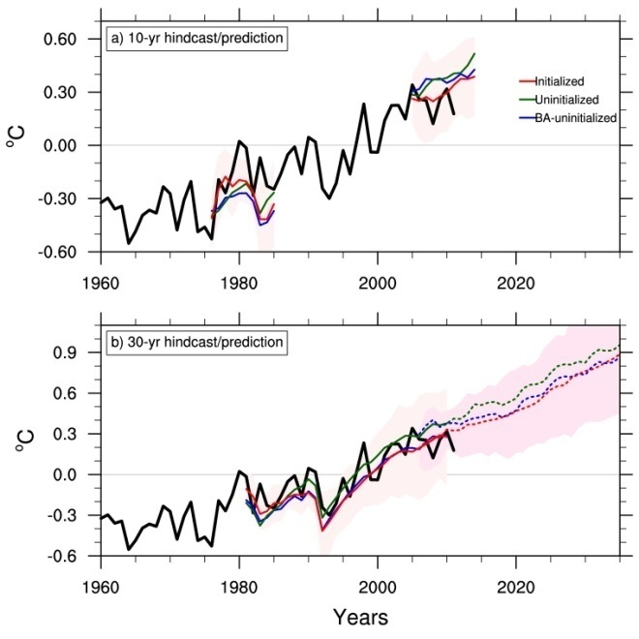
Lower estimates of near-term global warming from initialized climate models
Objective
Determine whether the recent slow-down of global warming, the “early-2000s hiatus”, can be simulated with climate models initialized with observations, and if those models produce different estimates of near-term warming than the traditional free-running uninitialized climate models.
Globally averaged surface air temperature anomalies, a) 10 year initialized simulations (red) that show greater warming for the 1970s shift and less warming for the early-2000s hiatus
Approach
A set of 16 climate models from the CMIP5 initialized experiments are analyzed to see if they can simulate the mid-1970s shift when there was rapid global warming, and the early-2000s hiatus when warming slowed
Compare predictions for 2016-2035 warming from the CMIP5 initialized models with the CMIP5 uninitialized climate models
than uninitialized (green), and b) less warming for a 30 year initialized prediction (red dashed) for 2016-2035 compared to free-running uninitialized projections (dashed blue), for the CMIP5 models.
Impact
Climate models that utilize the new methodology of initialized decadal climate prediction show increased capability in simulating past climate shifts, the early-2000s hiatus, as well as a 16% reduction of near-term global warming compared to the traditional uninitialized climate model projections.
Meehl, G.A., and H. Teng, 2014: CMIP5 multi-model initialized decadal hindcasts for the mid-1970s shift and early-2000s hiatus and predictions for 2016-2035. Geophys. Res. Lett., doi:10.1002/2014GL059256.

