Slide 1
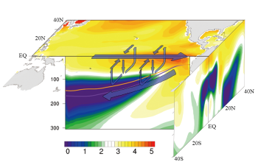
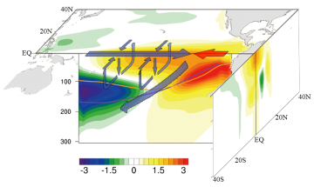
Understanding the El Niño-like Oceanic Response in the Tropical Pacific to Global Warming
Objective
Identify the ocean dynamical and thermodynamical contributions to the tropical Pacific warming in response to CO₂ forcing distinct from the processes during El Niño
Approach
Perform experiments using state-of-the-art ocean general circulation model (POP2 of the CESM)
Constraining wind fields to isolate the dynamical wind-stress feedback and thermodynamical wind-evaporation-SST feedback
Results
Weakening of the equatorial easterlies contributes secondarily to the eastern Pacific warming under CO₂ forcing, but plays a primary role in the circulation response in the subsurface structures
Air-sea thermal coupling holds the key to the warming response in the eastern Pacific
Global warming
Similarities and distinctions between the tropical Pacific response to global warming and the warm phase of the ENSO revealed by purposefully controlled ocean model experiments
El Niño
Impact
Revealed distinct dynamical contribution to eastern Pacific warming under CO₂ forcing compared to El Niño
The robust changes in the mean state of the tropical Pacific under global warming have profound impact not only on the tropical mean climate, but also the ENSO variability and its teleconnection
Luo Y, J Lu, F Liu, and W Liu. 2015. “Understanding the El Nino-like Oceanic Response in the Tropical Pacific to Global Warming.” Climate Dynamics. DOI:10.1007/s00382-014-2448-2.
Notes:
http://www.pnnl.gov/science/highlights/highlights.asp?division=749

