Slide 1
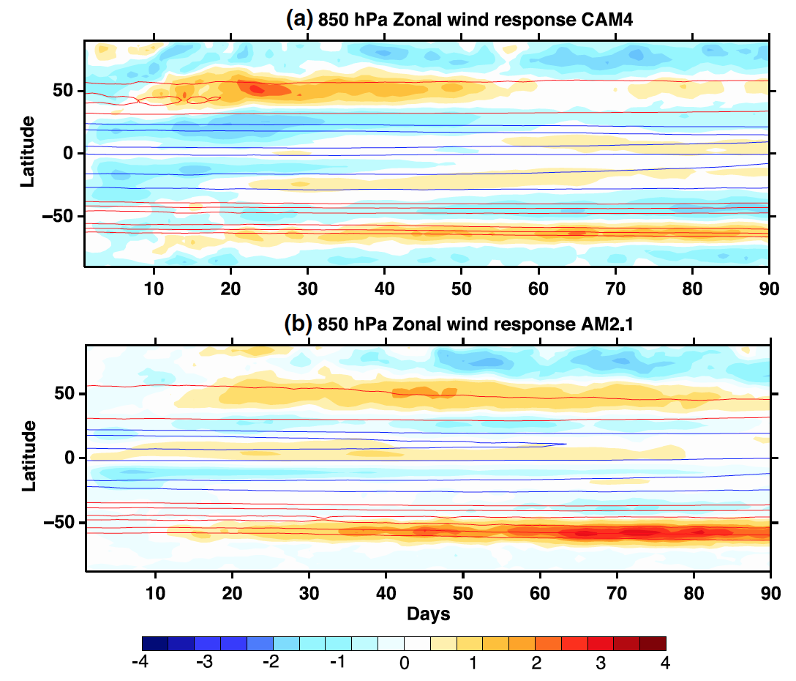
Investigating the Zonal Wind Response to SST Warming using Transient Ensemble AGCM Experiments
Objective
Investigate the robust poleward shift of the jet stream in response to global warming using forced large-ensemble Atmospheric General Circulation Model (AGCM) experiments.
Approach
Use a 320-member ensemble with NCAR’s CAM4 model and 640-member ensemble with Geophysical Fluid Dynamics Laboratory’s AM2.1 model
Employ a quasi-geostrophic potential voticity-based finite-amplitude wave activity budget including the diabatic wave activity source/sink
Identify the source of the potential vorticity gradient formation during the transient adjustment to sea-surface temperature forcing
Diagnose wave reflection index using reflecting phase speed
The time evolution of the ensemble mean near-surface zonal wind response in two AGCMs, showing characteristically similar poleward shift of jet stream in response to warming in both hemispheres
Impact
Bridging the gap between previous theoretical advance and realistic simulations of the circulation response to warming, this study furthers the understanding of the poleward jet shift, which is one of the most robust aspects of climate change, and its linkages to midlatitude extremes.
Palipane E, J Lu, P Staten, G Chen, and EK Schneider. 2016. “Investigating the Zonal Wind Response to SST Warming using Transient Ensemble AGCM Experiments.” Climate Dynamics. DOI: 10.1007/s00382-016-3092-9.
Notes:
http://www.pnnl.gov/science/highlights/highlights.asp?division=749

