Slide 1
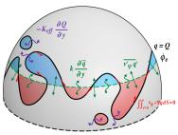
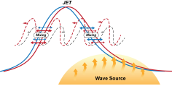
Towards the Dynamical Convergence on the Jet Stream in Aquaplanet AGCMs
Objective
Better understand the systematic sensitivity of the jet stream to the horizontal resolution of aquaplanet AGCMs
Develop a diagnostic framework for quantifying the dynamical convergence on jet stream
Approach
Perform aquaplanet model experiments with multiple horizontal resolutions
Apply finite-amplitude wave activity formalism to vorticity equation
Make use of the large Peclet number behavior of the quasi-two dimensional fluid
low resolution high resolution
Area-coordinate
Transformation
The PNNL research team developed a novel wave activity budget diagnostic to explain the convergence behavior of the jet stream.
Impact
This study discovered and explained a convergence behavior of the jet stream with increasing model horizontal resolution
The work suggests that models with 50km grid size might be close to fully capturing the jet stream dynamics
Findings offer a rule of thumb for the climate modeling centers to choose their AGCM resolution for the Coupled Model Inter-Comparison Project, phase 6
Lu J, G Chen, R Leung, D Burrows, Q Yang, K Sakaguchi, and S Hagos. 2015. “Towards the Dynamical Convergence on the Jet Stream in Aquaplanet AGCMs.” Journal of Climate, early online. DOI:10.1175/JCLI-D-14-00761.1.
Notes:
http://www.pnnl.gov/science/highlights/highlights.asp?division=749

