Slide 1
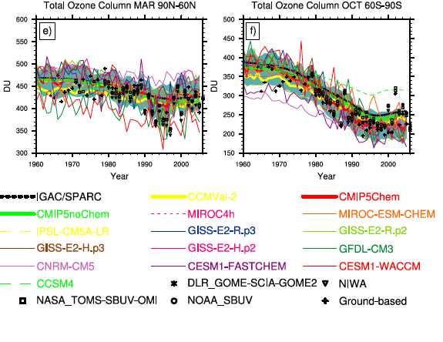
Long-term ozone changes and associated climate impacts in CMIP5 simulations
Objective
Undertake a multimodel assessment of ozone in the CMIP5 models and assess its influence on stratospheric temperature trends and the Southern Hemisphere atmospheric circulation in relation to GHG changes
Approach
Document ozone implementation in the CMIP5 models, particularly those with interactive chemistry
Use multimodel means to provide overview and individual model scatter diagrams to understand sensitivity of the climate response to the model’s ozone forcing
Obs
Impact
All CMIP5 models consider past ozone depletion and future ozone recovery, a significant advance over CMIP3. While the multimodel mean ozone agrees well with observations, individual models deviate. Future Southern Hemisphere summer-time circulation changes are sensitive to rates of both ozone recovery and GHG increases, with RCP2.6 showing a weak equatorward shift in the SH jet and RCP8.5 a robust poleward shift
Eyring V.F., Arblaster J.M., I. Cionni, J. Sedlacek, J. Perlwitz and co-authors 2013: Long-term ozone changes and associated climate impacts in CMIP5 simulations, J Geophys. Res., accepted

