Slide 1
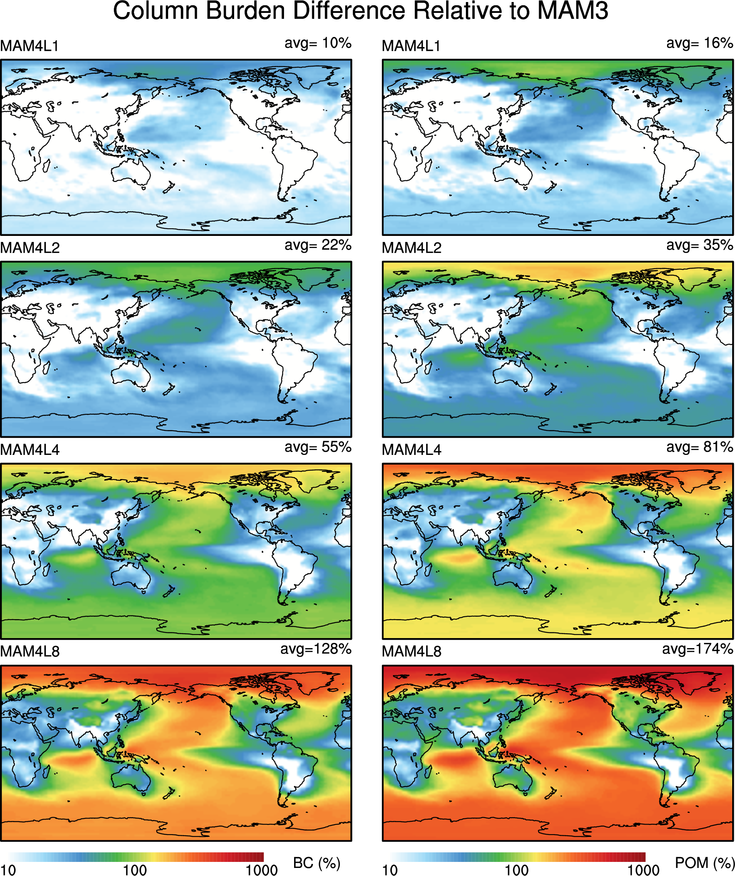
Improved representation of primary carbonaceous aerosol ageing
in CAM5 and ACME v1
Objective
To develop a four-mode version of the Modal Aerosol Module (MAM4) in CAM5 and ACME for better representation of microphysical ageing of primary carbonaceous aerosols (particulate organic matter and black carbon) in the atmosphere;
To improve the simulations of primary carbonaceous aerosols in the remote regions (e.g., Arctic) in CAM5 and ACME.
Approach
Implemented a primary carbon mode in MAM to explicitly treat the ageing of primary carbonaceous aerosols in the atmosphere;
Compared black carbon concentrations from free-run and specific dynamics simulations with observations.
Impact
MAM4 significantly increases modeled near-surface black carbon concentrations and improves the agreement with observations in the Arctic. This can have a large impact on Arctic clouds, radiation balance, surface air temperature, and snow melting.
Latitudinal and longitudinal distributions of the relative (percentage) differences of annual mean burdens of black carbon (left) and particulate organic matter (right) between MAM4 with different criteria of number of monolayers for ageing (i.e., MAM4L1, MAM4L2, MAM4L4, and MAM4L8 correspond to monolayers of 1, 2, 4 and 8, respectively) and MAM3. MAM4 significantly increases aerosol concentrations in the remote regions.
Liu, X., P.-L. Ma, H. Wang, S. Tilmes, B. Singh, R. C. Easter, S. J. Ghan, and P. J. Rasch: Description and evaluation of a new four-mode version of the Modal Aerosol Module (MAM4) within version 5.3 of the Community Atmosphere Model, Geosci. Model Dev., 9, 505–522, doi:10.5194/gmd-9-505-2016, 2016.

