Slide 1
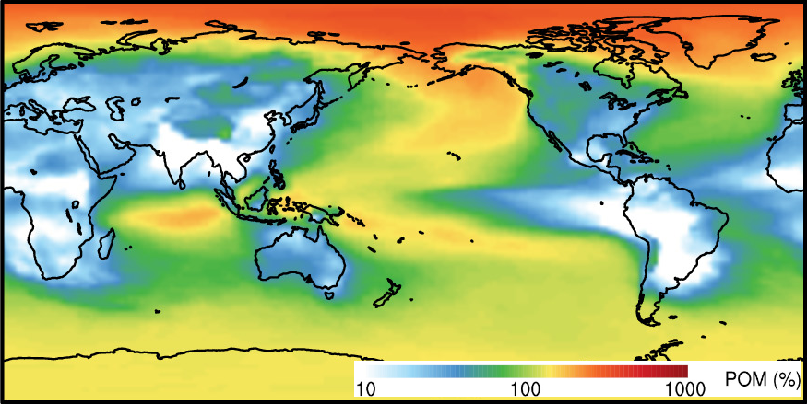
An Improved Minimal Representation of Aerosols for Climate Models
Particulate Organic Matter column burden
in MAM4 relative to MAM3
Objective
Improve the simulation of carbonaceous aerosols in remote locations
Approach
Add a fourth mode representing fresh, primary carbonaceous particles
Transfer carbonaceous aerosols to the accumulation mode as the fresh mode ages through condensation and coagulation
Evaluate simulations with and without the fresh mode by comparing with measurements
Delivery of carbonaceous aerosols to remote regions (such as the Arctic) increases significantly with the new MAM4 treatment.
Impact
The newly developed mode produces much more realistic carbonaceous aerosol concentrations in remote regions (such as the Arctic) with little additional computational cost.
Liu X, P-L Ma, H Wang, S Tilmes, B Singh, R Easter, S J Ghan, and PJ Rasch. 2016. “Description and Evaluation of a New 4-mode Version of Modal Aerosol Module (MAM4) within Version 5.3 of the Community Atmosphere Model.” Geoscientific Model Development 9:505-522. DOI:10.5194/gmd-9-505-2016.
Notes:
http://www.pnnl.gov/science/highlights/highlights.asp?division=749

